Slide 1
Putting the Fun in Functional Behavior Assessment

Slide 2
Functional Behavior
Assessment for Classroom Teachers
Revise the Environment
Replace the Behavior
Reframe the Response
Laura A. Riffel, Ph.D.
Notes:
3-D rings
(Intermediate)
To reproduce the effects on this slide, do the following:
On the Home tab, in the Slides group, click Layout, and then click Blank.
On the Home tab, in the Drawing group, click Shapes, and then under Basic Shapes click Donut (third row, second option from the left). On the slide, drag to draw a donut shape.
Select the donut shape. Drag the yellow diamond adjustment handle to the left to decrease the width of the donut shape.
Under Drawing Tools, on the Format tab, in the Size group, do the following:
In the Shape Height box, enter 4.17”.
In the Shape Width box, enter 4.17”.
Under Drawing Tools, on the Format tab, in the Shape Styles group, click the arrow next to Shape Fill, and then under Theme Colors click Aqua, Accent 5, Darker 25% (fifth row, ninth option from the left).
Under Drawing Tools, on the Format tab, in the Shape Styles group, click the arrow next to Shape Outline, and then click No Outline.
Under Drawing Tools, on the Format tab, in the Shape Styles group, click the Format Shape dialog box launcher. In the Format Shape dialog box, click 3-D Format in the left pane, and then do the following in the 3-D Format pane:
Under Bevel, click the button next to Top, and then under Bevel click Convex (second row, third option from the left). Next to Top, in the Width box, enter 5 pt, and then in the Height box, enter 5 pt. Click the button next to Bottom, and then under Bevel click Convex (second row, third option from the left). Next to Bottom, in the Width box, enter 5 pt, and then in the Height box, enter 5 pt.
Under Depth, click the button next to Color, and then under Theme Colors click Aqua, Accent 5, Darker 25% (fifth row, ninth option from the left). In the Depth box, enter 30 pt.
Under Surface, click the button next to Material, and then under Special Effect click Soft Edge (second option from the left). Click the button next to Lighting, and then under Neutral click Three Point (first row, first option from the left). In the Angle box, enter 30°.
Also in the Format Shape dialog box, click Shadow in the left pane, and then do the following in the Shadow pane:
Click the button next to Presets, and then under Outer click Offset Diagonal Bottom Left (first row, third option from the left).
In the Blur box, enter 11 pt.
In the Angle box, enter 90°.
Also in the Format Shape dialog box, click 3-D Rotation in the left pane. In the 3-D Rotation pane, click the button next to Presets, and then under Parallel click Off Axis 1 Top (second row, third option from the left).
On the Insert tab, in the Text group, click Text Box. On the slide, drag to draw a text box.
Enter text in the text box (Note: Enter three spaces before and after the text), select the text, and then on the Home tab, in the Font group, select Franklin Gothic Medium from the Font list and then select 24 from the Font Size list.
On the Home tab, in the Paragraph group, click Center to center the text in the text box.
Select the text box. Under Drawing Tools, on the Format tab, in the WordArt Styles group, click Text Effects, point to Transform, and then under Warp click Can Down (fourth row, fourth option from the left).
Drag the text box onto the donut shape.
On the text box, drag the pink diamond and blue adjustment handles to adjust the amount of text warp so that it matches the curve of the donut shape.
Under Drawing Tools, on the Format tab, in the WordArt Styles group, click the arrow next to Text Fill, point to Gradient, and then click More Gradients. In the Format Text Effects dialog box, click Text Fill in the left pane, select Gradient fill in the Text Fill pane, and then do the following:
In the Type list, select Linear.
In the Angle box, enter 0°.
Under Gradient stops, click Add gradient stops or Remove gradient stops until three stops appear in the slider.
Also under Gradient stops, customize the gradient stops as follows:
Select the first stop in the slider, and then do the following:
In the Position box, enter 0%.
Click the button next to Color, and then under Theme Colors click White, Background 1 (first row, first option from the left).
In the Transparency box, enter 0%.
Select the next stop in the slider, and then do the following:
In the Position box, enter 30%.
Click the button next to Color, and then under Theme Colors click White, Background 1 Darker 15% (third row, first option from the left).
In the Transparency box, enter 0%.
Select the last stop in the slider, and then do the following:
In the Position box, enter 100%.
Click the button next to Color, and then under Theme Colors click White, Background 1, Darker 35% (fifth row, first option from the left).
In the Transparency box, enter 0%.
Press CTRL-A to select the shape and the text. One the Home tab, in the Drawing group, click Arrange, and then click Group.
Select the group. On the Home tab, in the Clipboard group, click the arrow to the right of Copy, and then click Duplicate.
Select the second shape group, and then, on the slide, drag it slightly above and to the right of the first donut shape.
Select the text in the second text box and edit the text.
Select the second donut shape. Under Drawing Tools, on the Format tab, in the Size group, do the following:
In the Shape Height box, enter 3.75”.
In the Shape Width box, enter 3.75”.
Drag the second text box onto the second donut shape.
On the second text box, drag the pink diamond and blue adjustment handles to adjust the amount of text warp so that it matches the curve of the second donut shape.
Select the second donut shape. Under Drawing Tools, on the Format tab, in the Shape Styles group, click the arrow next to Shape Fill, and then under Theme Colors click Purple, Accent 4, Darker 25% (fifth row, eighth option from the left).
Also under Drawing Tools, on the Format tab, in the Shape Styles group, click the Format Shape dialog box launcher. In the Format Shape dialog box, click 3-D Format in the left pane. In the 3-D Format pane, under Depth, click the button next to Color, and then under Theme Colors click Purple, Accent 4, Darker 25% (fifth row, eighth option from the left).
Press and hold CTRL, and then select the second donut shape and text box. On the Home tab, in the Clipboard group, click the arrow to the right of Copy, and then click Duplicate.
Drag the third donut shape and text box slightly above and to the left of the second donut shape.
Click the third text box and edit the text.
Select the third donut shape. Under Drawing Tools, on the Format tab, in the Size group, do the following:
In the Shape Height box, enter 3.33”.
In the Shape Width box, enter 3.33”.
Drag the third text box onto the third donut shape.
On the third text box, drag the pink diamond and blue adjustment handles to adjust the amount of text warp so that it matches the curve of the third donut shape.
Select the third donut shape. Under Drawing Tools, on the Format tab, in the Shape Styles group, click the arrow next to Shape Fill, and then under Theme Colors click Olive Green, Accent 3, Darker 25% (fifth row, seventh option from the left).
Also under Drawing Tools, on the Format tab, in the bottom right corner of the Shape Styles group, click the Format Shape dialog box launcher. In the Format Shape dialog box, click 3-D Format in the left pane. In the 3-D Format pane, under Depth, click the button next to Color, and then under Theme Colors click Olive Green, Accent 3, Darker 25% (fifth row, seventh option from the left).
Select the first donut shape. On the Home tab, in the Drawing group, click Arrange, and then click Send to Back.
To reproduce the background effects on this slide, do the following:
On the Design tab, in the Background group, click Background Styles, and then click Format Background. In the Format Background dialog box, click Fill in the left pane, select Gradient fill in the Fill pane, and then do the following:
In the Type list, select Linear.
In the Angle box, enter 270.
Under Gradient stops, click Add gradient stops or Remove gradient stops until two stops appear in the slider.
Also under Gradient stops, customize the gradient stops as follows:
Select the first stop in the slider, and then do the following:
In the Position box, enter 31%.
Click the button next to Color, and then under Theme Colors click White, Background 1 (first row, first option from the left).
In the Transparency box, enter 0%.
Select the next stop in the slider, and then do the following:
In the Position box, enter 100%.
Click the button next to Color, click More Colors, and then in the Colors dialog box, on the Custom tab, enter values for Red: 200, Green: 201, Blue: 193.
In the Transparency box, enter 0%.

Slide 3
Recorded Version (Free)
https://behaviordoctor.teachable.com
Direct link
https://tinyurl.com/apbsfba2bip

Slide 4
1999-2003 SLIIDEA Project
When Congress passed the Individuals with Disabilities Education Act (IDEA) in 1997, it sanctioned an appraisal to pursue progress at the state and local levels on the legislative goals of IDEA. The U.S. Department of Education's Office of Special Education Programs (OSEP) contracted a national longitudinal study, the Study of State and Local Implementation and Impact of the Individuals with Disabilities Education Act (SLIIDEA), toward that culmination. This presentation integrates information from SLIIDEA pertaining to escalating the use of positive interventions for tackling behavioral issues of students with individualized education programs (IEPs), as suggested in a comparison of the 1999-2000 data to 2002-2003 data.

Slide 5
What we really need to change behavior:
Antecedent | Behavior | Consequence
These can be setting events which occurred in the near distant past or antecedent triggers which occur immediately before. | This is the behavior you are targeting for change- one bite at a time. | This is the reinforcement received from engaging in the behavior.
Antecedent Manipulations | Replacement Behavior | Consequence Modification
Things you do to change the environment to set the student up for success. | Things you teach the student to replace the targeted behavior. | Things you do to change yourself so you don’t feed the behavior
Samples- Pages 42-44

Slide 6
What we really need to change behavior:
Trigger | Target | impacT
These can be setting events which occurred in the near distant past or antecedent triggers which occur immediately before. | This is the behavior you are targeting for change- one bite at a time. | This is the reinforcement received from engaging in the behavior.
Revise the Environment | Replace the Behavior | Reframe the Response
Things you do to change the environment to set the student up for success. | Things you teach the student to replace the targeted behavior. | Things you do to change yourself so you don’t feed the behavior
Samples- Pages 42-44

Slide 7
What is your definition of functional behavior assessment?
Discuss with your neighbor for two minutes- one minute each

Slide 8
2 minute bar timer
End
Notes:
This bar timer, will start when anywhere on the slide is clicked. The bar will move from left to right and the word ‘End’ will appear at the end, accompanied by a ‘Deep Gong’ sound. It is possible to change the duration of this timer to any time, by entering the animation settings, and changing the timing for ‘rectangle 3’. Note the time has to be entered as a number of seconds – so if you want 2mins & 30secs – this is entered as 150 (60X2 + 30 = 150).

Slide 9
A Behavioral Intervention Plan should be based on a Functional Behavioral Assessment (FBA)
FBA is a process for gathering information to understand the function (purpose) of behavior in order to develop an effective intervention plan.

Slide 10
The goal of this presentation
Show you how to train your staff in a simple and effective way for them to collect their own data
This data would then be shared with the behavior support team for behavioral intervention planning that is based on data
We’ve spent years figuring out why data seems to be a four letter word to some
We’ve simplified the process
We’ve trained thousands on how to use the Free FBA Data Tool
Let’s look at a real student

Slide 11
Meet Scout
Scout is a sixth grade student in a K-6 grade school. She is with the same teacher all day and in a class of 25 students. The school has 476 students and is a neighborhood school. She has not been retained and is a “young” student in the class compared to her peers. Her older sisters are both in high school and are very athletic and popular with many friends. Scout tends to hang out with the sisters’ friends and rarely has friends her own age over to the house.
Page 9 & 10

Slide 12
Scout- page 9
Scout is a sixth grade student with mild intellectual disabilities. Scout has two peers who attend the nearby high school. Scout’s mother works full time and father frequently travels. He leaves on Sunday evening and returns on Friday afternoon.
Scout’s behaviors at school are disruptive outbursts, physical aggression, and throwing objects.
Mom reports Scout is disorganized at home and leaves her stuff laying all over the house. Mom says she is so disorganized they have three or four fights every morning. She says she has to drive Scout to school because she would make the whole bus late if they waited on Scout. Mom says Scout eats everything in sight when she gets home from school and fights with her sisters until her Mom gets home in the evening.
Scout is included in the regular classroom with support provided by a co-teaching special education teacher who works with the regular classroom teacher.

Slide 13
Scout’s Strengths and Needs
Social Strengths | Academic Strengths | Social Needs | Academic Needs
Comfortable talking in front of the whole class Great supportive family Vocabulary is advanced for her age | Scout is very visual and can draw pictures better than anyone in the class Scout always turns in her work Scout has neat cursive handwriting | Scout is very comfortable with adults but needs to make friends with peers Scout needs help with transitions Scout needs to keep hands and feet to self | Scout needs help with reading comprehension Scout needs help with reading fluency Scout needs help in learning to ask for help
Page 9

Slide 14
Scout’s Behaviors
Throwing objects means a physical object leaves Scout’s hands with purpose and lands at least 12 inches from her body | Disruptive outburst means a loud verbal sound or word that comes from Scout and disturbs the learning environment | Horseplay means any part of Scout’s body comes in contact with another person with minimal force (Volkswagen slug bug tap)
Page 10

Slide 15
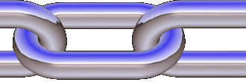
You have 10 days of data – Pages 16-17- Starting with May 1, 2008
Only one letter in each space. Time is not time that student is with you- it’s the time the behavior started and ended.

Slide 16
You have 10 days of data – Pages 12-13- Starting with May 1, 2008

Slide 17
When we are training on the tool, we usually have the participants score it by hand first so they understand what they are looking at on the tool.
The reader will flip between pages 16-17 and give information to the recorders.
Recorders you will go to page 19 and start writing the information given to you.

Slide 18
The discussions are rich- Just walk around and listen to all the brainstorming that begins when people start really analyzing data. Hand tallying pages are on pages 14--18

Slide 19
School psychologist quote from one of our seminars.

Slide 20
Behavior Analysis
Page 14

Slide 21
Behavior Analysis
Page 15

Slide 22
Behavior Analysis
38 %
Page 15

Slide 23
Behavior Analysis
Not enough incidents to measure
Page 16

Slide 24
Behavior Analysis
Page 16

Slide 25
Behavior Analysis
Horseplay
Page 17

Slide 26
Behavior Analysis
Page 18
Horseplay (c)

Slide 27
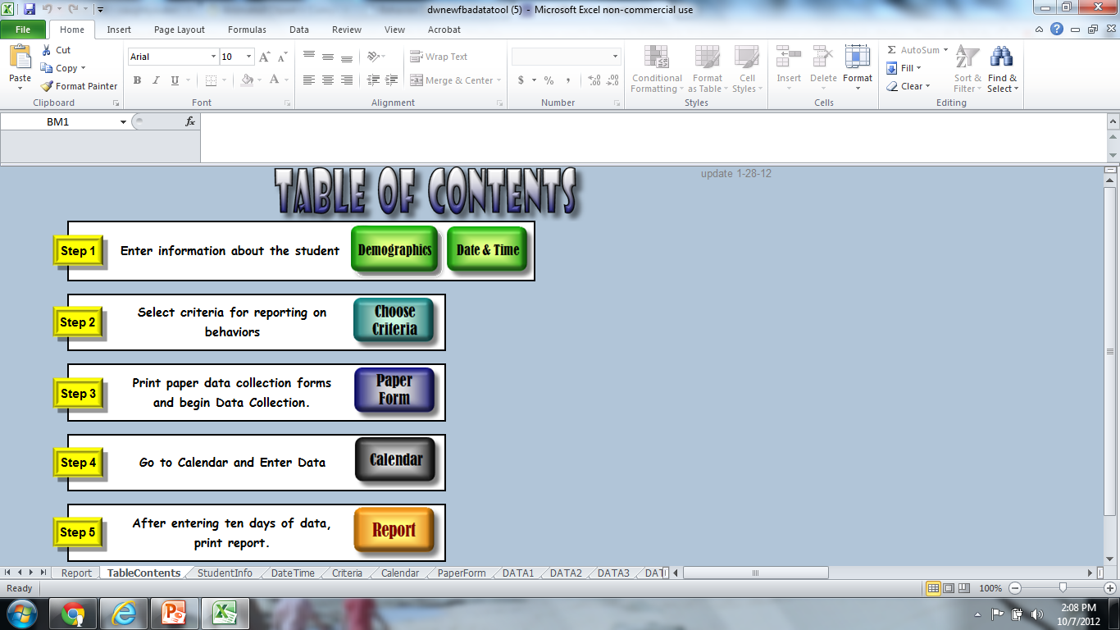
Click on Demographics

Slide 28
Enter your identifying information here
Then click this

Slide 29
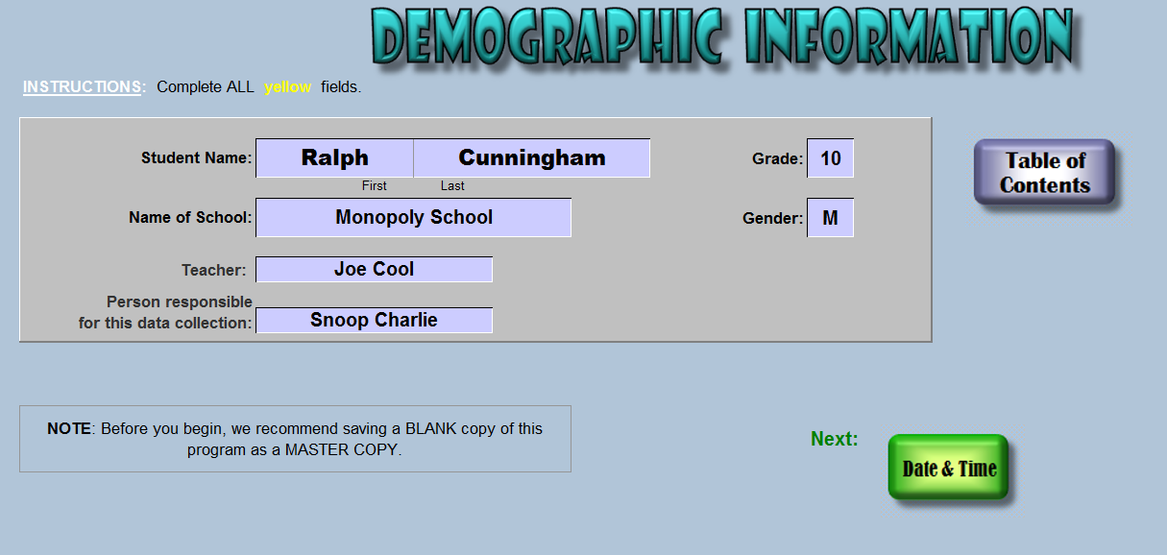
Then click this

Slide 30
Put in the time you will begin data collection & the date & school year
Then click this

Slide 31
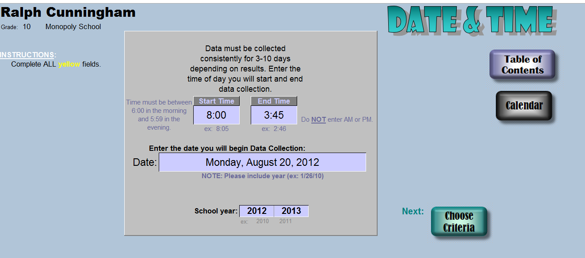
Then click this

Slide 32
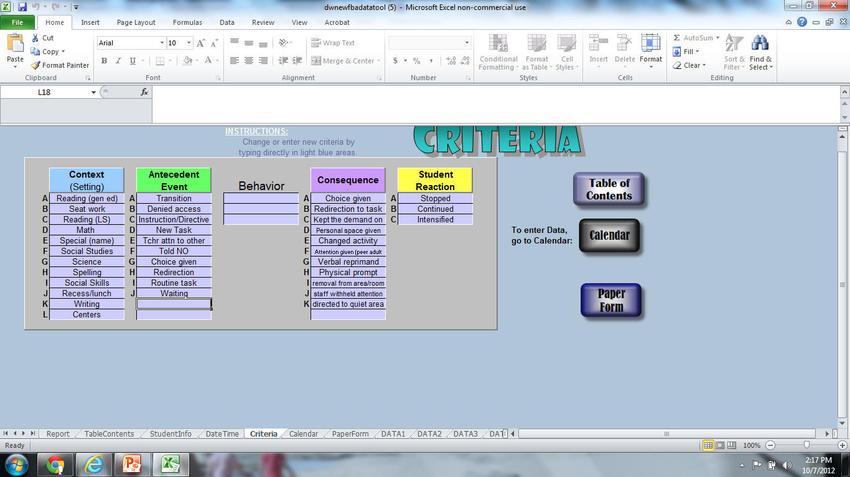
Change the criteria to match your student’s setting, event, behavior and consequence

Slide 33
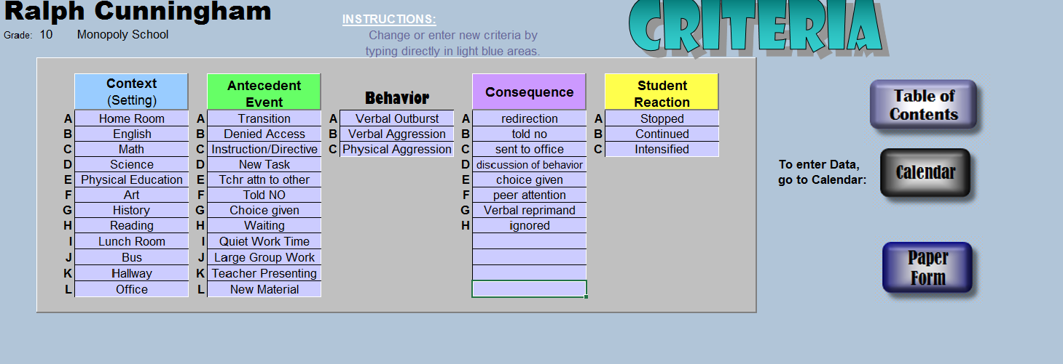
Then you would click this

Slide 35
After the team has collected data- click Calendar and start entering data.

Slide 36
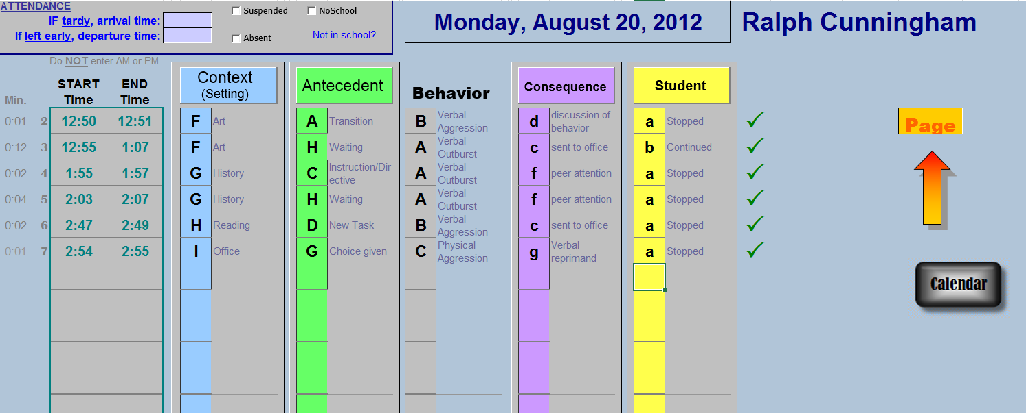

Slide 38
After you have entered all your data- click “Report” and you will get all the graphs.

Slide 39
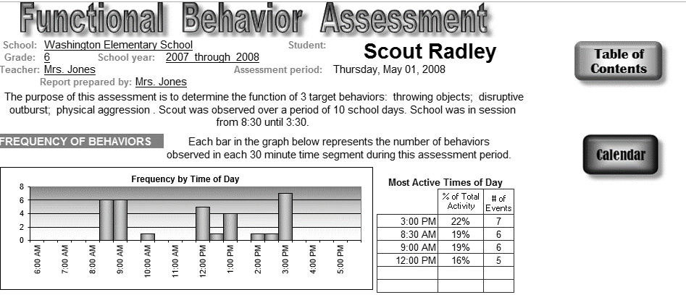
What pattern do you see?
Page 18

Slide 40
What pattern do you see?
Page 18

Slide 41
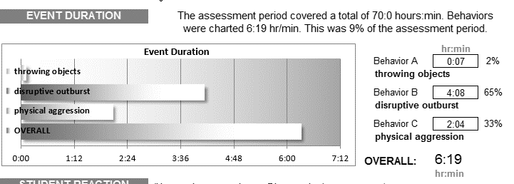
What pattern do you see?
horseplay
horseplay
Page 19

Slide 42
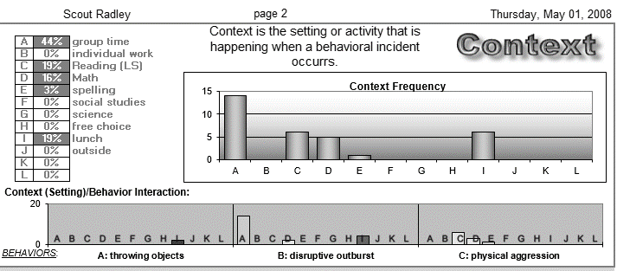
What pattern do you see?
C: Horseplay
Page 19

Slide 43
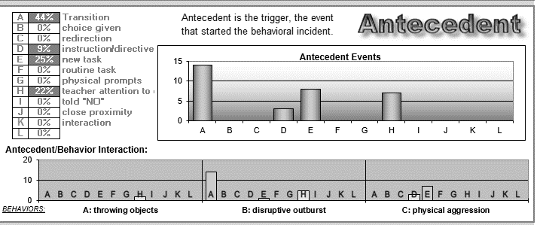
What pattern do you see?
C: Horseplay
Page 19

Slide 44
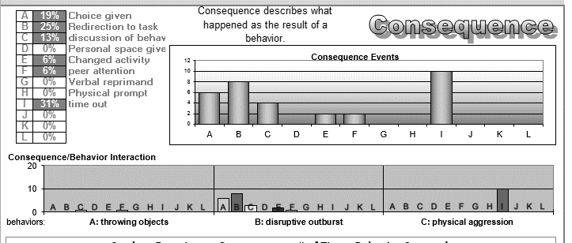
What patterns do you see?
C: Horseplay
Page 20

Slide 45
Summary Statement
Page 20
When this happens:
Scout does this:
To gain or escape this:
Transition
Disruptive outburst (burps)
To gain adult attention

Slide 46
Page
22
horseplay
horseplay
Trigger | Target | impacT
 | Disruptive Outburst
transitions

Slide 47
Page
23
horseplay
Trigger | Target | impacT
 | Disruptive Outburst | To get adult attention
Transitions

Slide 48
Summary Statement
Page 20
When this happens:
Scout does this:
To gain or escape this:
New Work is Assigned
Horseplay
To escape work

Slide 49
Page
22
horseplay
horseplay
Trigger | Target | impacT
 | Horseplay
New tasks assigned

Slide 50
Page
23
horseplay
Trigger | Target | impacT
 | Horseplay
New tasks

Slide 51
Page
23
horseplay
Trigger | Target | impacT
 | Horseplay | To escape work
New tasks

Slide 52
Old version
What adult or peer behaviors will reinforce this behavior in the long term?
What is the goal behavior?
8
7
What adult or peer behaviors are reinforcing this behavior? (Negative or positive reinforcement) (Consequences)
What event or setting takes place prior to the target behavior? (Antecedent)
What behavior are you targeting to change? (Behavior)
Transitions
Adult Attention
Disruptive
Outburst
2
3
1
What new behaviors might you teach to the student to replace the current target behaviors?
How might you change the adult behavior regarding the original target behavior and the new replacement behaviors?
What settings/contexts/antecedents can you modify to make proactive changes in the environment to make the target behavior unnecessary?
4
5
6

Slide 53
Page 24- New Triple T- Triple R Chart
Trigger | Target | impacT
When there is a transition paired with group time | Scout has a Disruptive Outburst | To get adult attention.
Revise the Environment | Replace the Behavior | Reframe the Response

Slide 54
Page 24- New Triple T- Triple R Chart
Trigger | Target | impacT
When there is a transition paired with group time | Scout has a Disruptive Outburst | To get adult attention.
Revise the Environment | Replace the Behavior | Reframe the Response
Make her Vanna White of the Daily Schedule. Mom works on organizing her exit from home. Check-in/Check-out with a preferred adult. Had her go to the office with a “message” or return a “book” to the library if it looked like she was on overload and needed attention. (Cued receivers) | Writing on the board and announcing to the class the next activity. Secret signal if she wants the teacher’s attention. | She’s getting pre-corrects of attention from the teacher prior to her Vanna White duties. Teacher gives a ton of attention for appropriate behavior. Teacher ignores burping. The minute she is quiet- she gets attention. If needed private conversation.

Slide 55
What adult or peer behaviors will reinforce this behavior in the long term?
What is the goal behavior?
8
7
What adult or peer behaviors are reinforcing this behavior? (Negative or positive reinforcement) (Consequences)
What event or setting takes place prior to the target behavior? (Antecedent)
What behavior are you targeting to change? (Behavior)
Escape
New Task
Physical Horse
Play
2
3
1
What new behaviors might you teach to the student to replace the current target behaviors?
How might you change the adult behavior regarding the original target behavior and the new replacement behaviors?
What settings/contexts/antecedents can you modify to make proactive changes in the environment to make the target behavior unnecessary?
4
5
6

Slide 56
Page 25- Triple T- Triple R Chart
Trigger | Target | impacT
When there is a new task that involves reading | Scout engages in horseplay | To escape work.
Revise the Environment | Replace the Behavior | Reframe the Response

Slide 57
Page 25- Triple T- Triple R Chart
Trigger | Target | impacT
When there is a new task that involves reading | Scout engages in horseplay | To escape work.
Revise the Environment | Replace the Behavior | Reframe the Response
Pre-teach her the upcoming lessons in the privacy of her check-in/check-out room. She will know the first thing the teacher is going to ask for her anticipatory set. | Teach her to use her secret signal if she is stuck so she doesn’t resort to out of seat behavior. Keep some extra supplies over on a shelf and tell her if she is stuck to get up and go get one of those supplies. That will cue the teacher she needs help without disturbing the class. | Give tons of attention for working on seatwork. If she does “hit”, she loses choice at recess. She still goes to recess, but she cannot play four square which is her favorite game. If she does work well, she can earn five free answers for the whole class on the assignment.

Slide 58
Baseline
Baseline
Intervention

Slide 59
Formula for Baseline-
(I-B)/B= D*100
Intervention Frequency = 3 times per day
Baseline Frequency = 34 times per day
3-34= -31
-31/34= -.91176
-.91*100=
-91% Decrease in Behavior

Slide 60
FBA Tool
https://tinyurl.com/riffelfbatool
This is a free tool that graphs antecedent, behavior, consequence data to feed into your Triple T- Triple R Chart

Slide 61
Laura A. Riffel caughtyoubeinggood@gmail.com www.behaviordoctor.org www.facebook.com/behaviordoctor www.twitter.com/behaviordoctor

