Slide 1
Ten Precepts of Behavior
Laura A. Riffel, Ph.D
www.behaviordoctor.org
www.facebook.com/behaviordoctor
caughtyoubeinggood@gmail.com.

Slide 2
www.behaviordoctor.org
Go to the materials tab
Click “Presentations”
Scroll to San Bernardino
I have posted this PowerPoint and some other files I think you might really like.
www.facebook.com/behaviordoctor

Slide 3
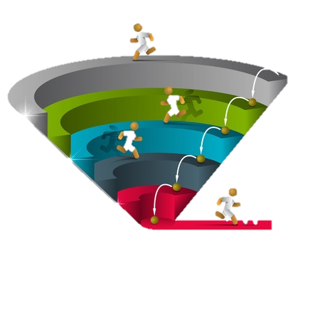
ALL
Some
Few

Slide 4
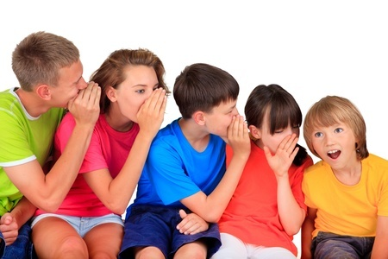
1
Behavior is learned and serves a specific purpose
(Bandura and Glasser)
If you are given a task you don’t want to do…start crying. They will send you to the “thinking” chair.
Handout pg 1
Page 7

Slide 5
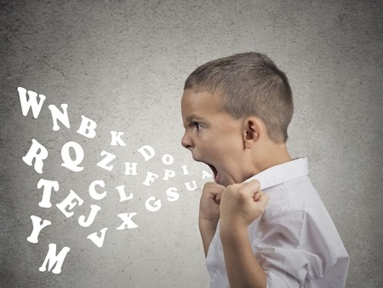
Josh- 4 hours a day

Slide 6
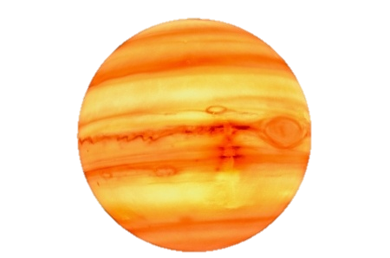
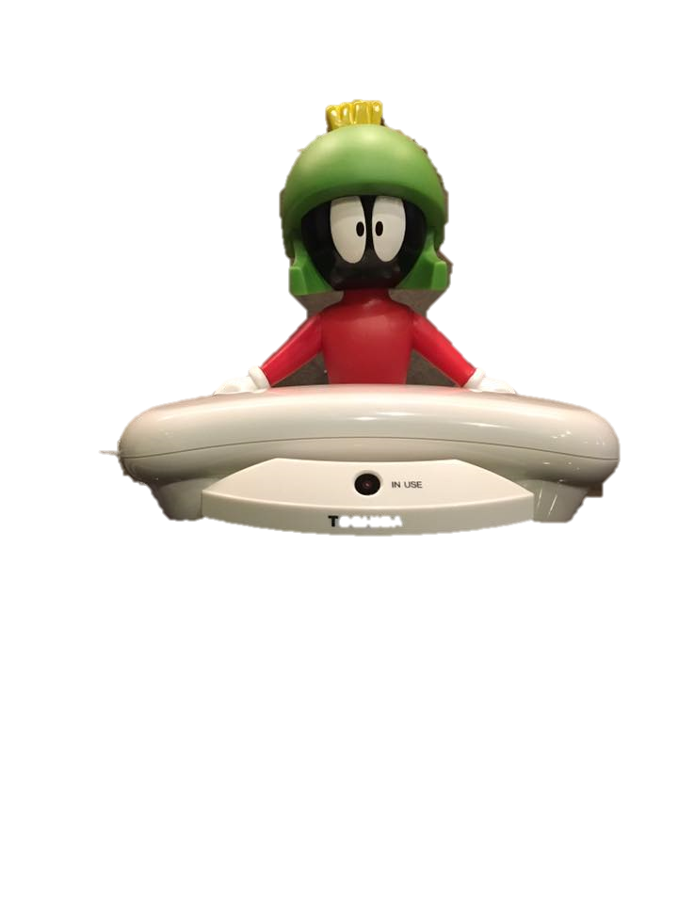
2
Behavior is related to the context within which it occurs (Bambara & Knoster)
This would never happen on Mars!!!
Royalty free pic from clipartbest.com
Handout pg 1
Page 7

Slide 7
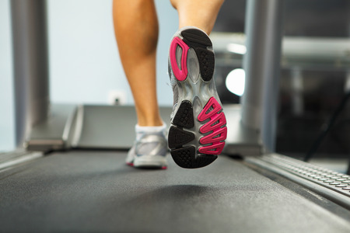
3
We should deliver the intervention with consistency and fidelity for one month for every year that the behavior has been in place (Lally et al.).
Handout pg 1
Page 7

Slide 8
Josh - learning

Slide 9
4
Behavior goes….
Where reinforcement flows
We can improve behavior by 80% just by pointing out what one person is doing correctly (Shores, Gunter, & Jack).
Handout pg 1
Page 7

Slide 10
5
We know we can improve behavior by labeling with behavior specific praise; but we use it less than 10% of the time (Haydon et al.)
Handout pg 1
Page 7

Slide 11
NYC Preschool for children

Slide 12
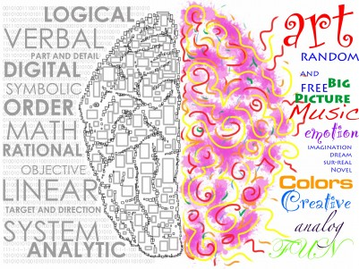
6
L R
When we want compliance from a non-compliant student, we should offer equal choices and deliver the direction from the right side of the student (Cosden et al.; and Tomassi & Marzoli).
Page 7

Slide 13
Cortez, Colorado

Slide 14
7
It’s all fun and games
Until
Someone….
…Figures out the function
Of your behavior.
All behavior falls into two categories(Alberto & Troutman):
Page 7

Slide 15
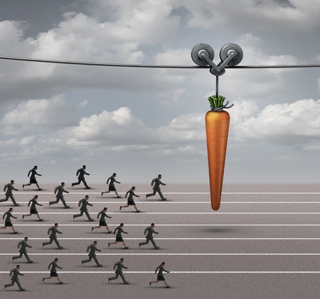
8
These are the things students are trying to access:
Attention (eyeballs)
Access to preferred items
Sensory input
Handout pg 1
Page 7

Slide 16
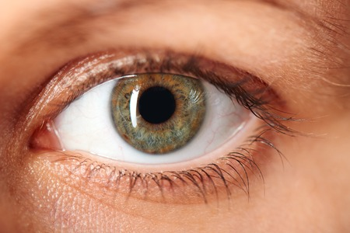
TUMS
Touch them
Use their name in a positive way
Make eye contact
Smile
Give it on the front side
They won’t take it on the back side.

Slide 17
Sensory input

Slide 18
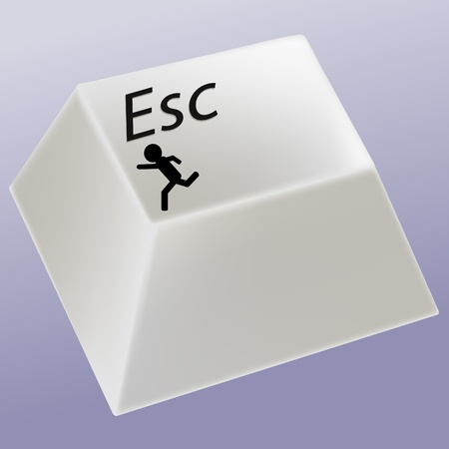
9
These are the things students are trying to escape:
Work/Tasks
Attention (Adults-Peers)
Pain (Physical or Emotional)
Sensory Overload
Page 7

Slide 19
Sensory overload- If these happen stop activity and assess
Physical | Verbal | Behavior
Loss of Balance | Verbalizing “STOP” | Refusing Activities
Skin flushes/goes pale | Hysteria/Crying | Stimming
Racing Heartbeat | Echolalic Behavior | Child lashes out
Stomach distress: stomach ache – nausea-vomiting |  | Agitated or Angry

Slide 20
Real Example- David, the kindergartener

Slide 21
10
Whenever a behavior happens, it is your reaction that determines whether you see it again or not. We have to change our behavior (Alberto & Troutman)..
Handout pg 1
Page 7

Slide 22
Jay and the pancakes

Slide 23
Test to see if it is a real intervention
Did it stop the behavior?
Was it proactive: not reactive?
Were there changes to the environment to set the student up for success?
Was a replacement behavior taught?
Did the team feed the replacement behavior and extinguish the target behavior?
Was it delivered long enough with consistency and fidelity?

Slide 24
References
Alberto, P.A., & Troutman, A.C. (1990). Applied behavior analysis for teachers (Third Edition). New York: Macmillan Publishing Company.
Alberto, P., & Troutman, A. (2003). Applied behavior analysis for teachers (6th ed.). Upper Saddle River, NJ: Merrill Prentice-Hall.
Bambara, L.M., & Knoster, T.P. (1995). Guidelines: Effective behavioral support. Pennsylvania Department of Education: Bureau of Special Education.
Bandura, A. (1969a). Principles of behavior modification. New York: Holt, Rinehart & Winston.
Cosden, M., Gannon, C., & Haring, T. G. (1995). Teacher-control versus student-control over choice of tasks and reinforcement for students with severe behavior problems. Journal of Behavioral Education, 5, 11-27.
Haydon, T., Conroy, M., Sindelar, P., Scott, T. M., Brian, & Marie, A. (2010). Comparison of Three Types of Opportunities to Respond on Student Academic and Social Behaviors, Journal of Emotional and Behavioral.
Lally, P., Van Jaarsveld, C. H. M., Potts, H., & Wardle, J. (2010). How are habits formed: Modeling habit formation in the real world. European Journal of Social Psychology, 40, 998–1009. doi:10.1002/ejsp.674.
Marzoli D & Tommasi L (2009). Side biases in humans (Homo sapiens); three ecological studies on hemispheric asymmetries. Naturwissenschaften. DOI 10.1007/s00114-009-0571-4.
Shores, R. E., Gunter, P. L., & Jack, S. L. (1993). Classroom management strategies: Are they setting events for coercion? Behavioral Disorders, 18, 92–102.

Slide 25
Pictures
All pictures were purchased through 123rf.com with the exception of Marvin the Martian owned by Laura Riffel

