Slide 1
Proven Reinforcers to Create a Climate of Appreciation in Your School
Laura a. riffel, ph.d.

Slide 2
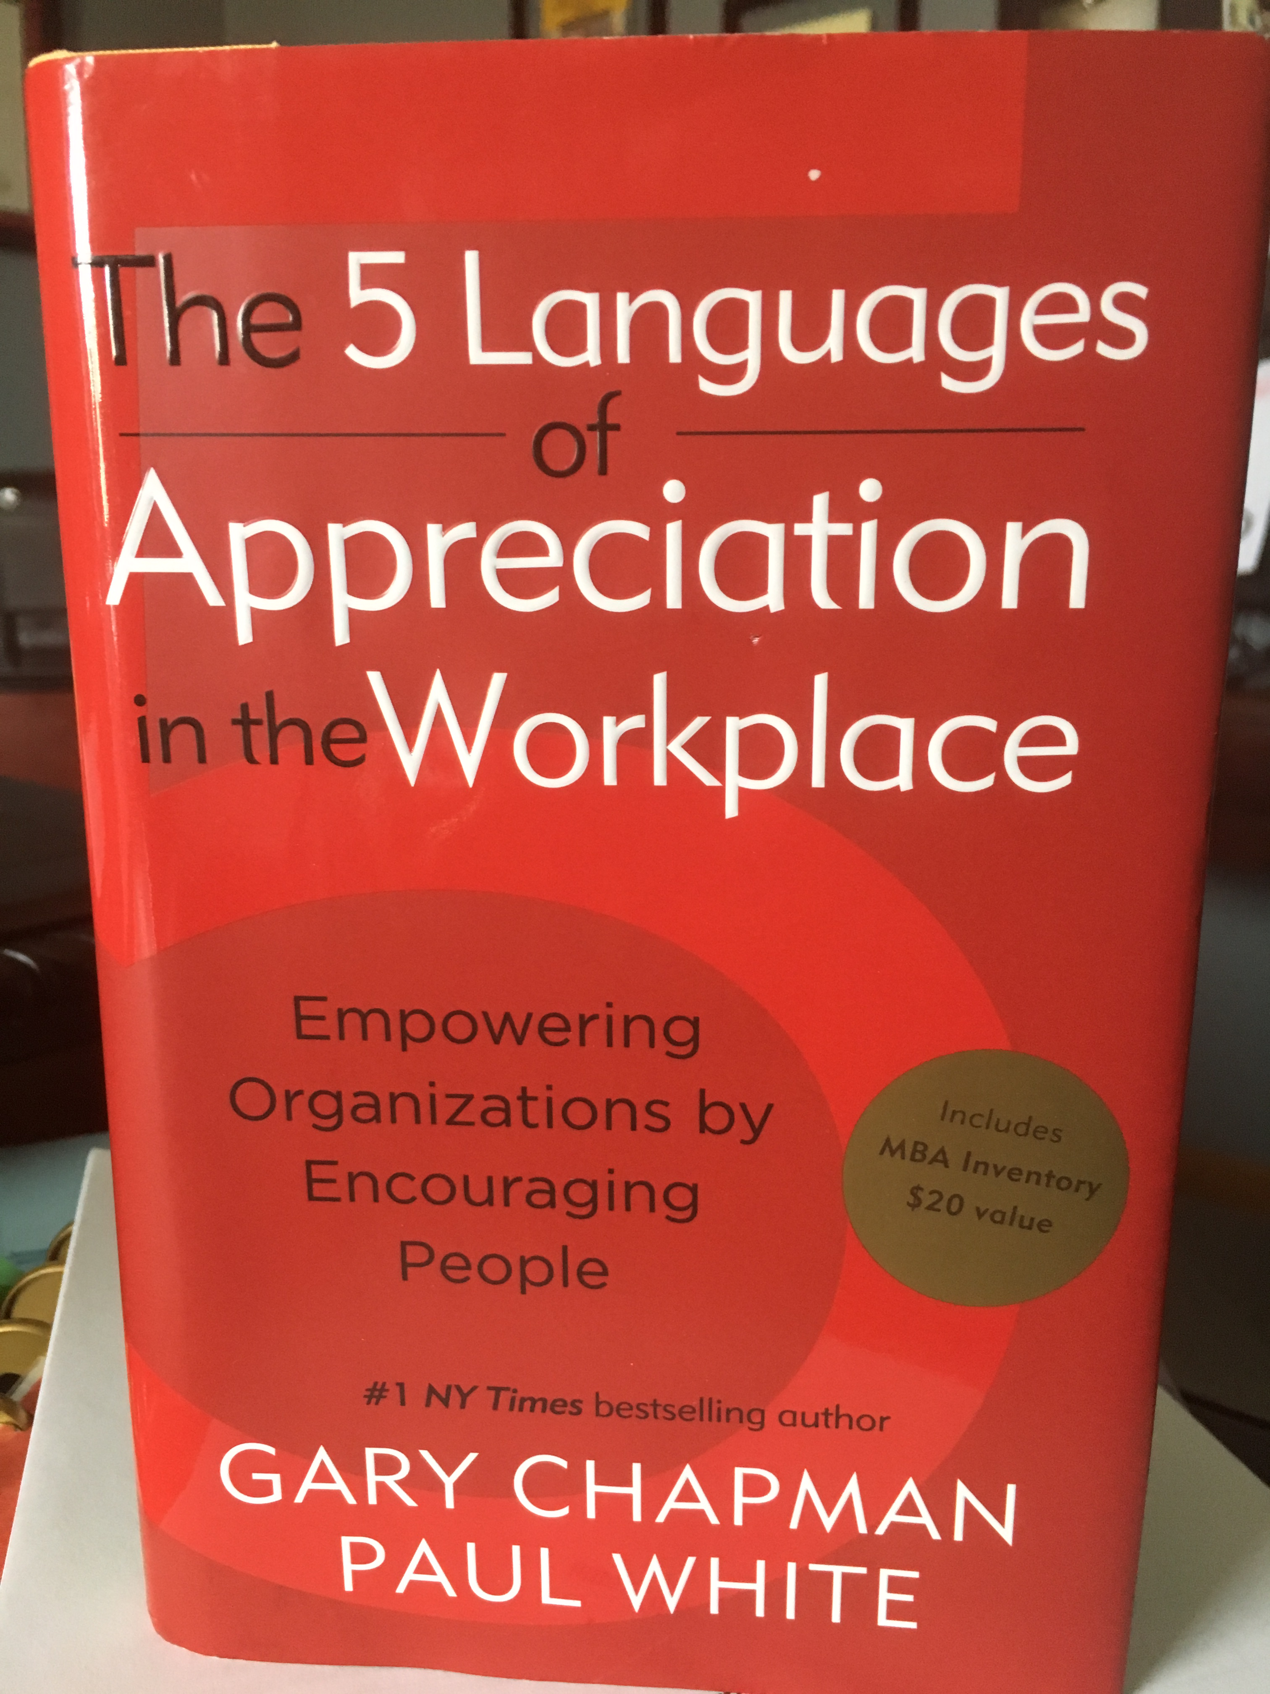
Five languages of appreciation in the workplace
Chapman & White (2012)
Words of Affirmation
Quality Time
Acts of Service
Tangible Gifts
Physical Touch

Slide 3
All gotchas should be delivered with behavior specific praise. Our leadership team of middle school students made a video for the staff: (we will provide a link)
Torrington Middle School
Torrington, Wyoming

Slide 4
Reinforcements

Slide 5
PALPATES
1) Privileges (Earning special privileges)
2) Attention (Quality Time with Adults and Peers)
3) Leadership (Earning Leadership Roles)
4) Praise (Social Praise- Name in Lights)
5) Assistance (Special Assistance in a Topic of Their Choice)
6) Touch (High Five)
7) Escape (Escape from a Task or Chore)
8) Supplies (School Supplies)

Slide 6
Privileges

Slide 7
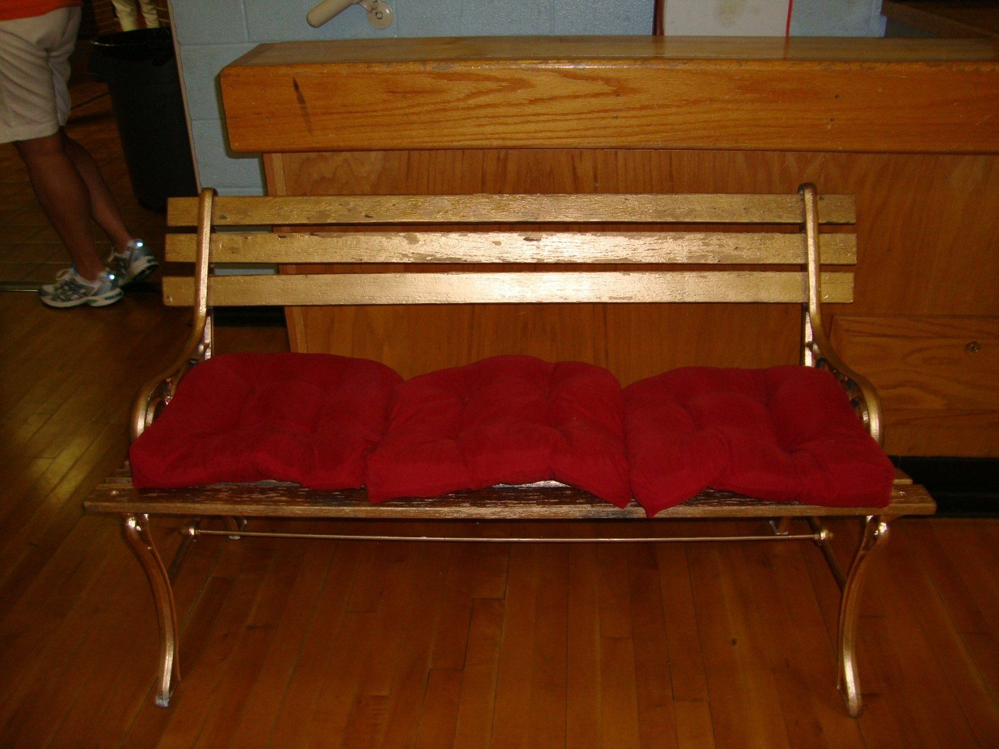
Donate benches for benches of honor
©BDS

Slide 8
Get to design a teacher’s hair and she has to wear it that way all day.
©BDS

Slide 9
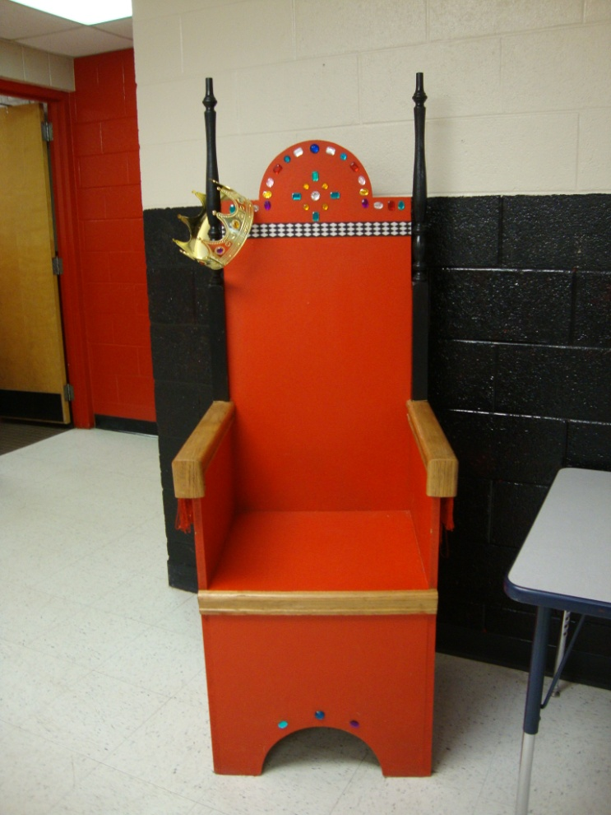
This was made by a grandparent at one of our schools- one student gets to sit in the throne and invite 3 friends to eat with them at the table.
©BDS

Slide 10
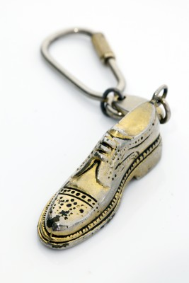
CEO- Keychain
Permission to park by the front door in the visitor’s parking spot- for high school students.

Slide 11
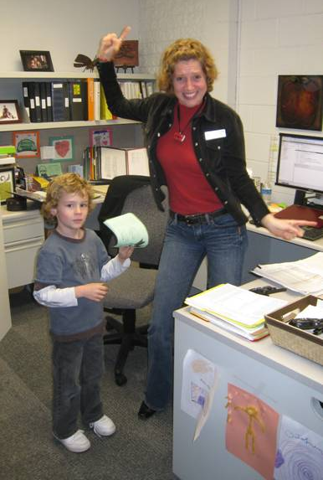
Instant winners: Dance with principal and positive phone call home (every 25th gotcha has a stamp on it)
Briarglen Elementary
©BDS
Notes:
Briarglen Elementary- Tulsa, Oklahoma

Slide 12
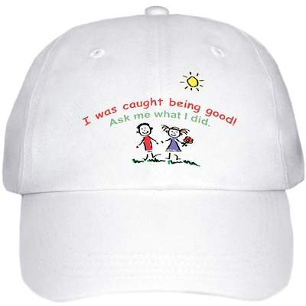
www.vistaprint.com
Notes:
If parents would go to www.vistaprint.com – they could order many items for very little money that will allow students to get attention for exhibiting excellent behavior. This is a hat that could be worn as a badge of honor and then given back each day for another student to wear the next day.

Slide 13
Get to eat lunch with a former military veteran and ask questions.

Slide 14
Get to put your handprint on a buddy bench on the playground.

Slide 15
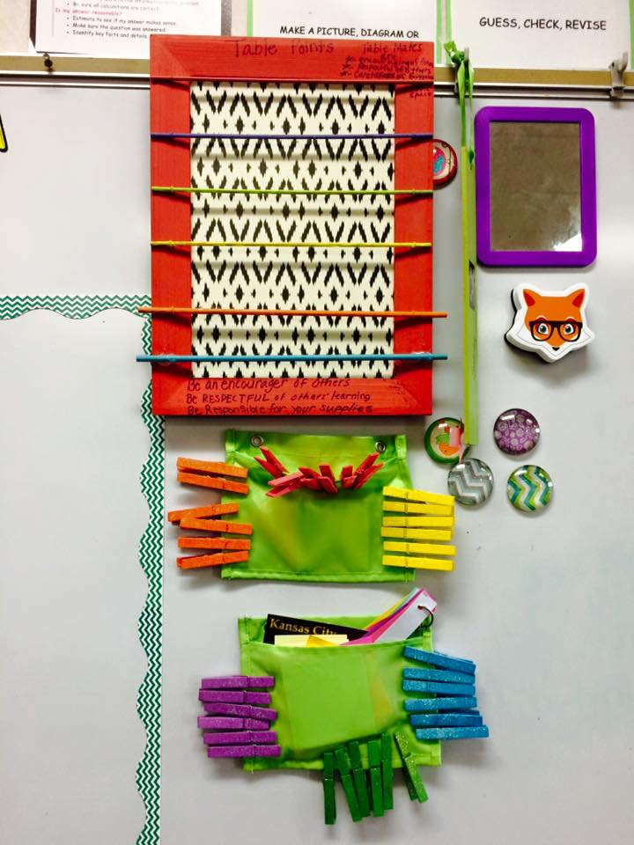
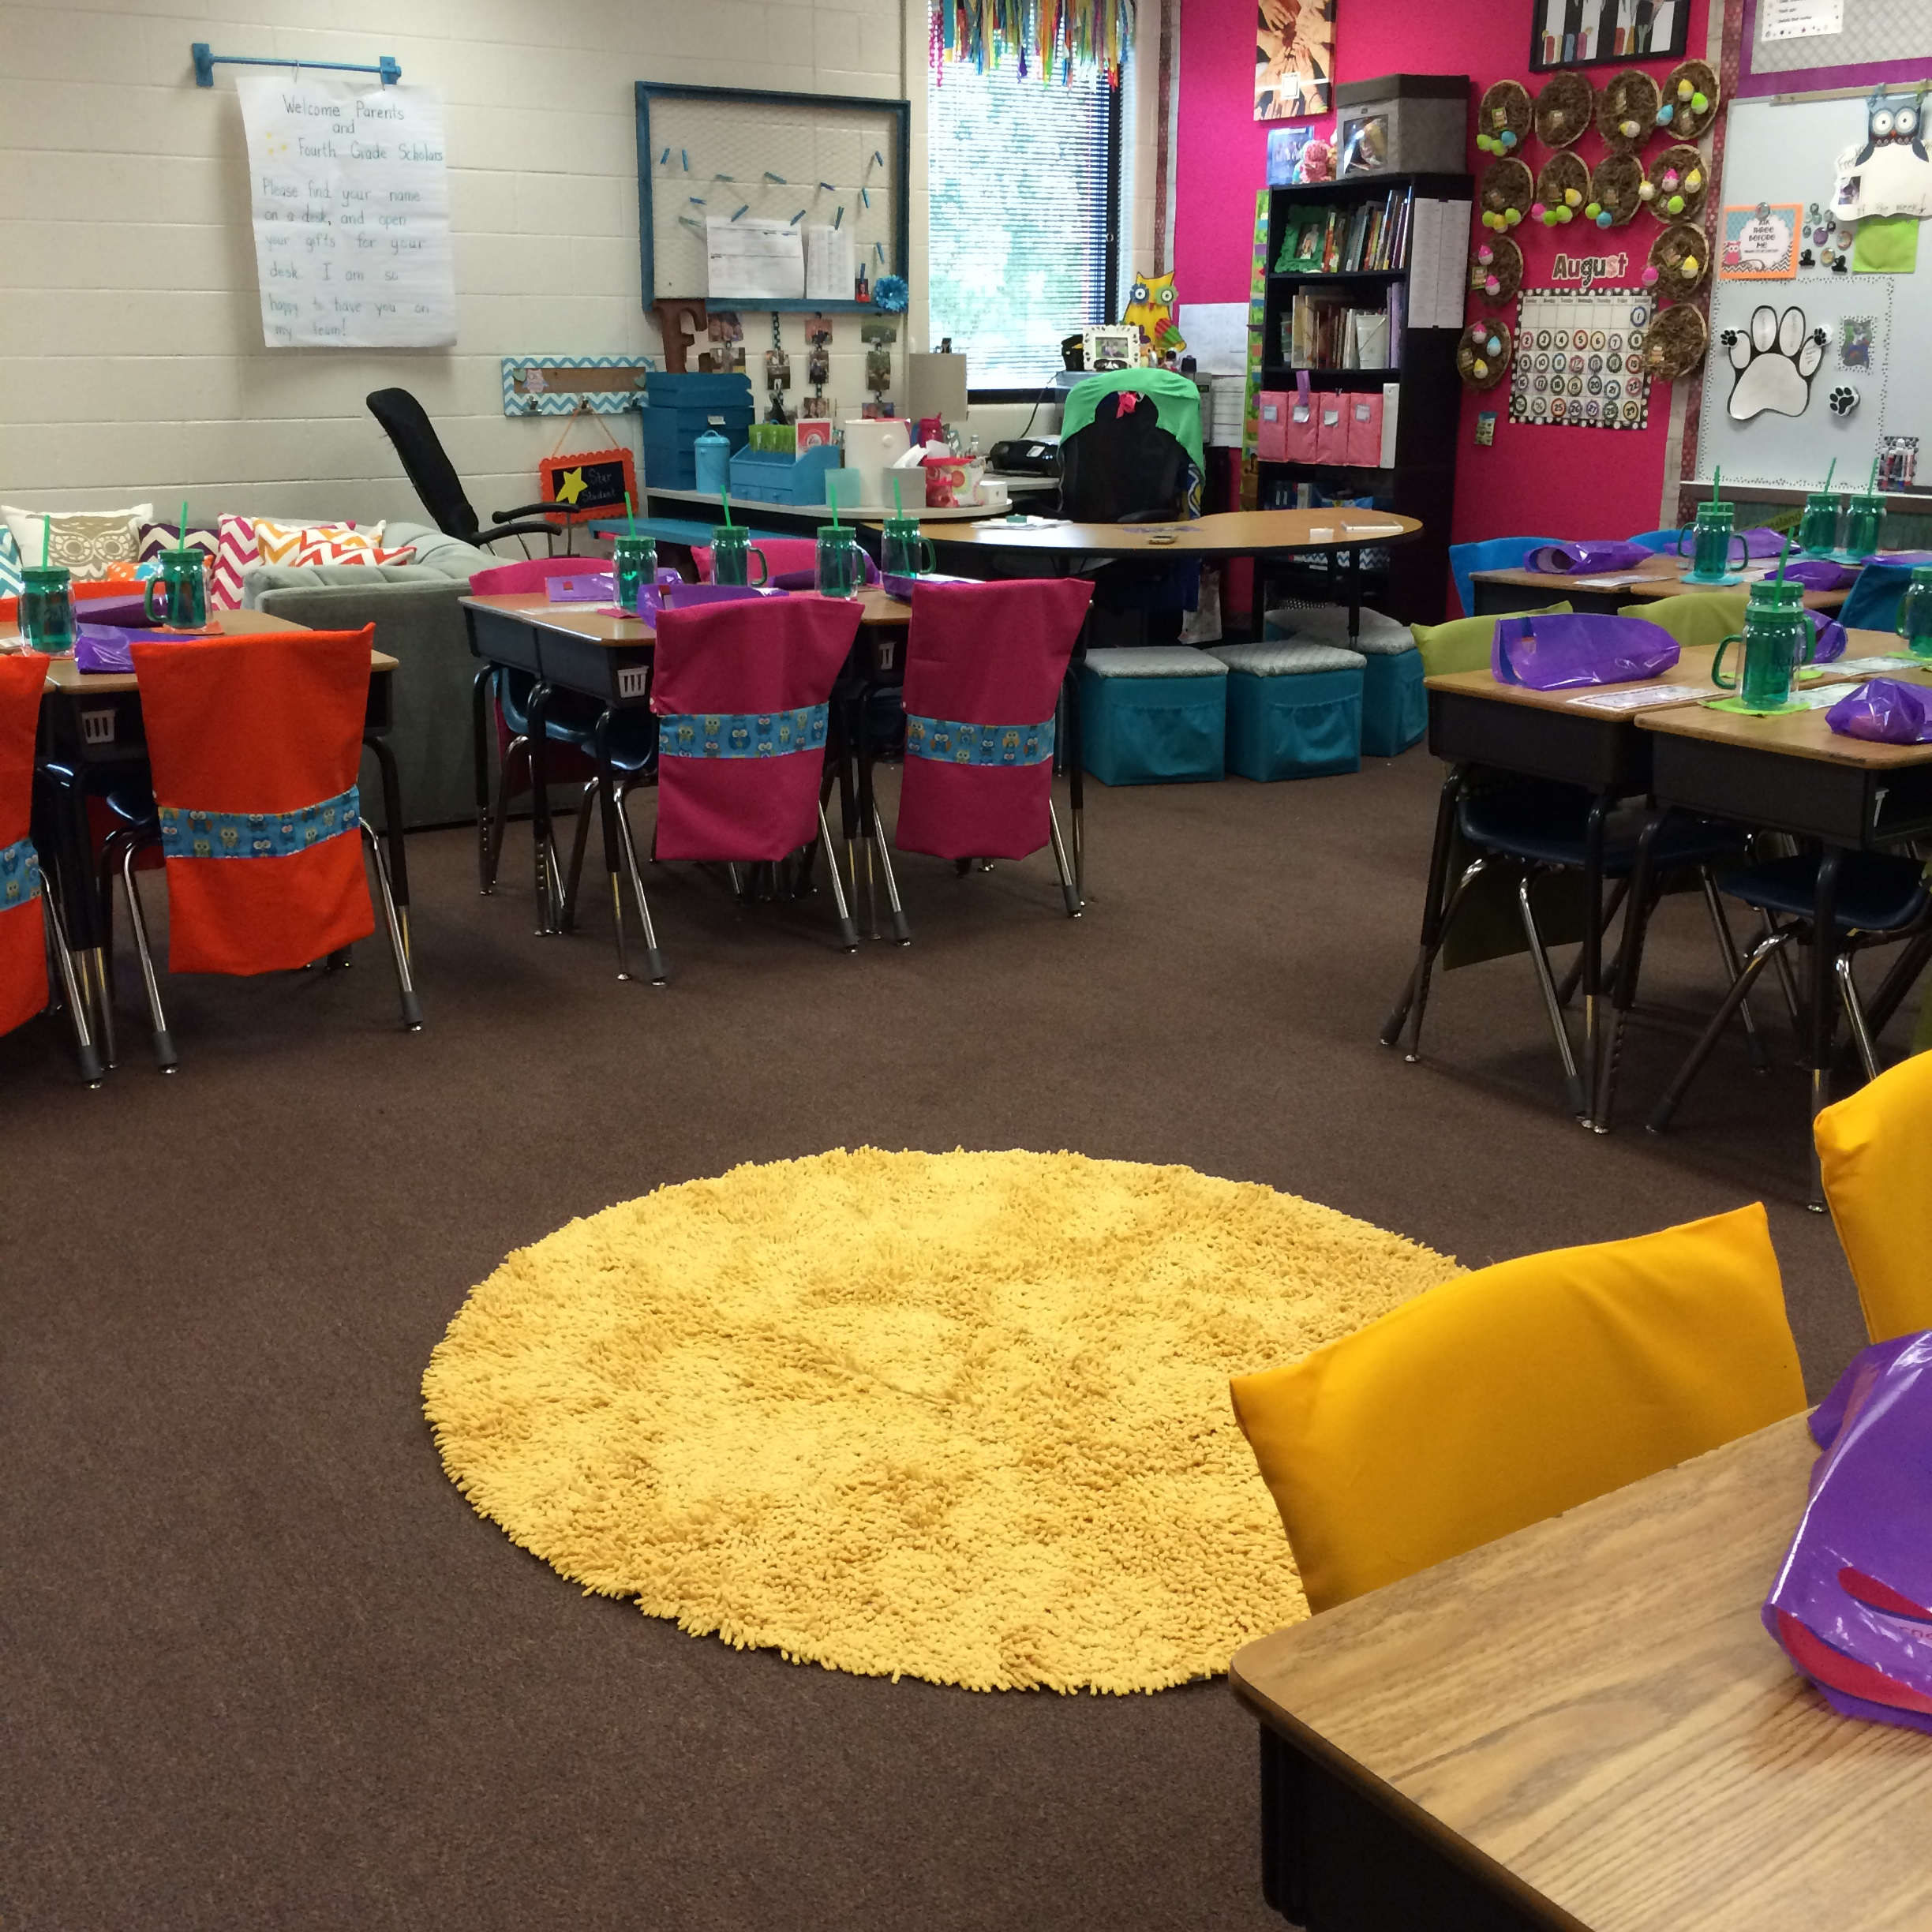
Special seating for table that earns the most points during shared reading.

Slide 16
Get to wear a silly hat for the day- even if it’s not your birthday.

Slide 17
Buzz cut a design in a willing participant’s head.

Slide 18
Special seating during assemblies or games.

Slide 19
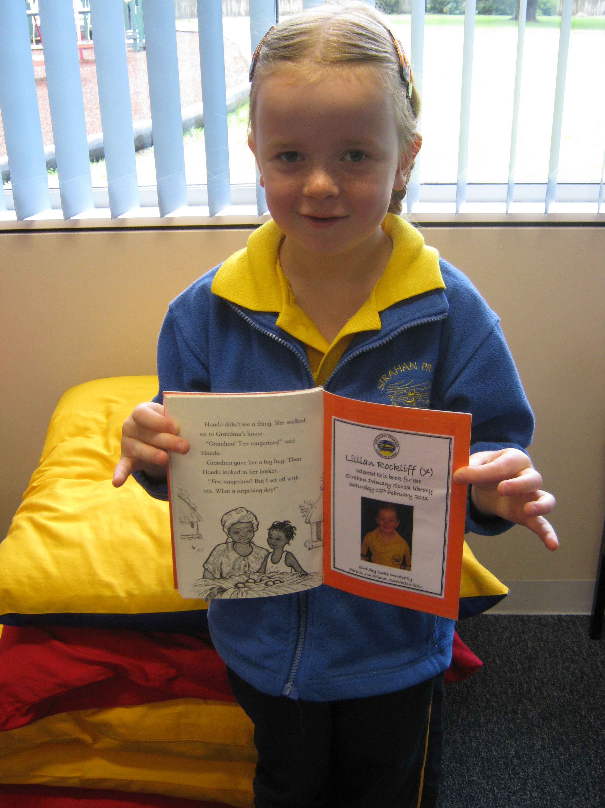
Get to have a book dedicated to you in the library.

Slide 20
Student reading to a therapy dog at middle school.

Slide 21
Get to sit in a special chair for dear time.

Slide 22
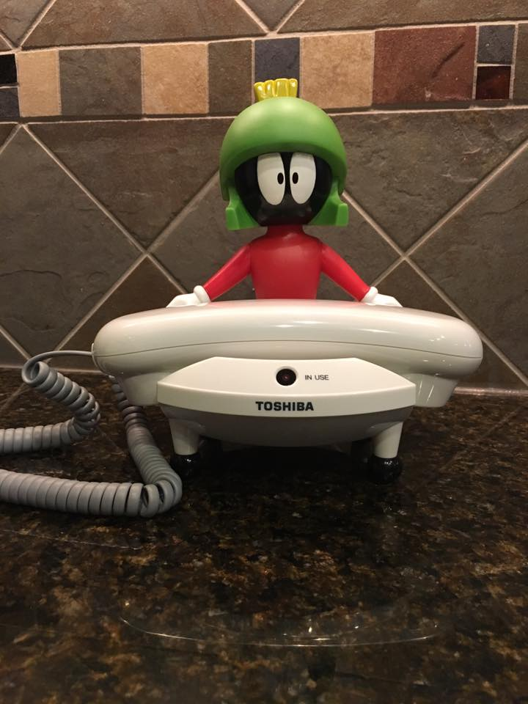
Get to make a positive phone call home from the principal’s hot line.

Slide 23
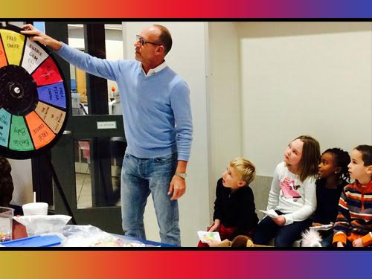
Mr. Oborny spins gotcha wheel for privilege coupons

Slide 24
Donate limo services
©BDS
Notes:
Pleasant Ridge Elementary – Olathe, Kansas

Slide 25
attention

Slide 26
Name in lights
Paired with Behavior Specific Praise

Slide 27
Washington Elementary Olathe, KS
©BDS

Slide 28
www.vistaprint.com
Notes:
These are magnets that could be given out to take home-

Slide 29
www.vistaprint.com
Notes:
This is a window decal that can be printed and given to the child to put on their parent’s car.

Slide 30
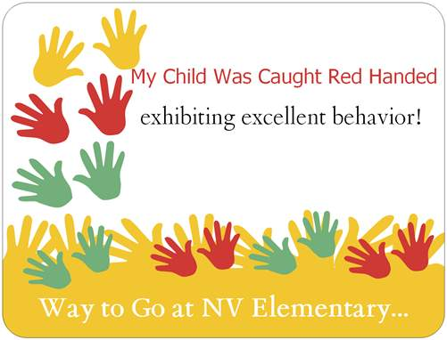
www.vistaprint.com
Notes:
This is a car magnet- Elementary students can give this to their parents and high school students can use it to get special parking spaces close to the school.

Slide 31
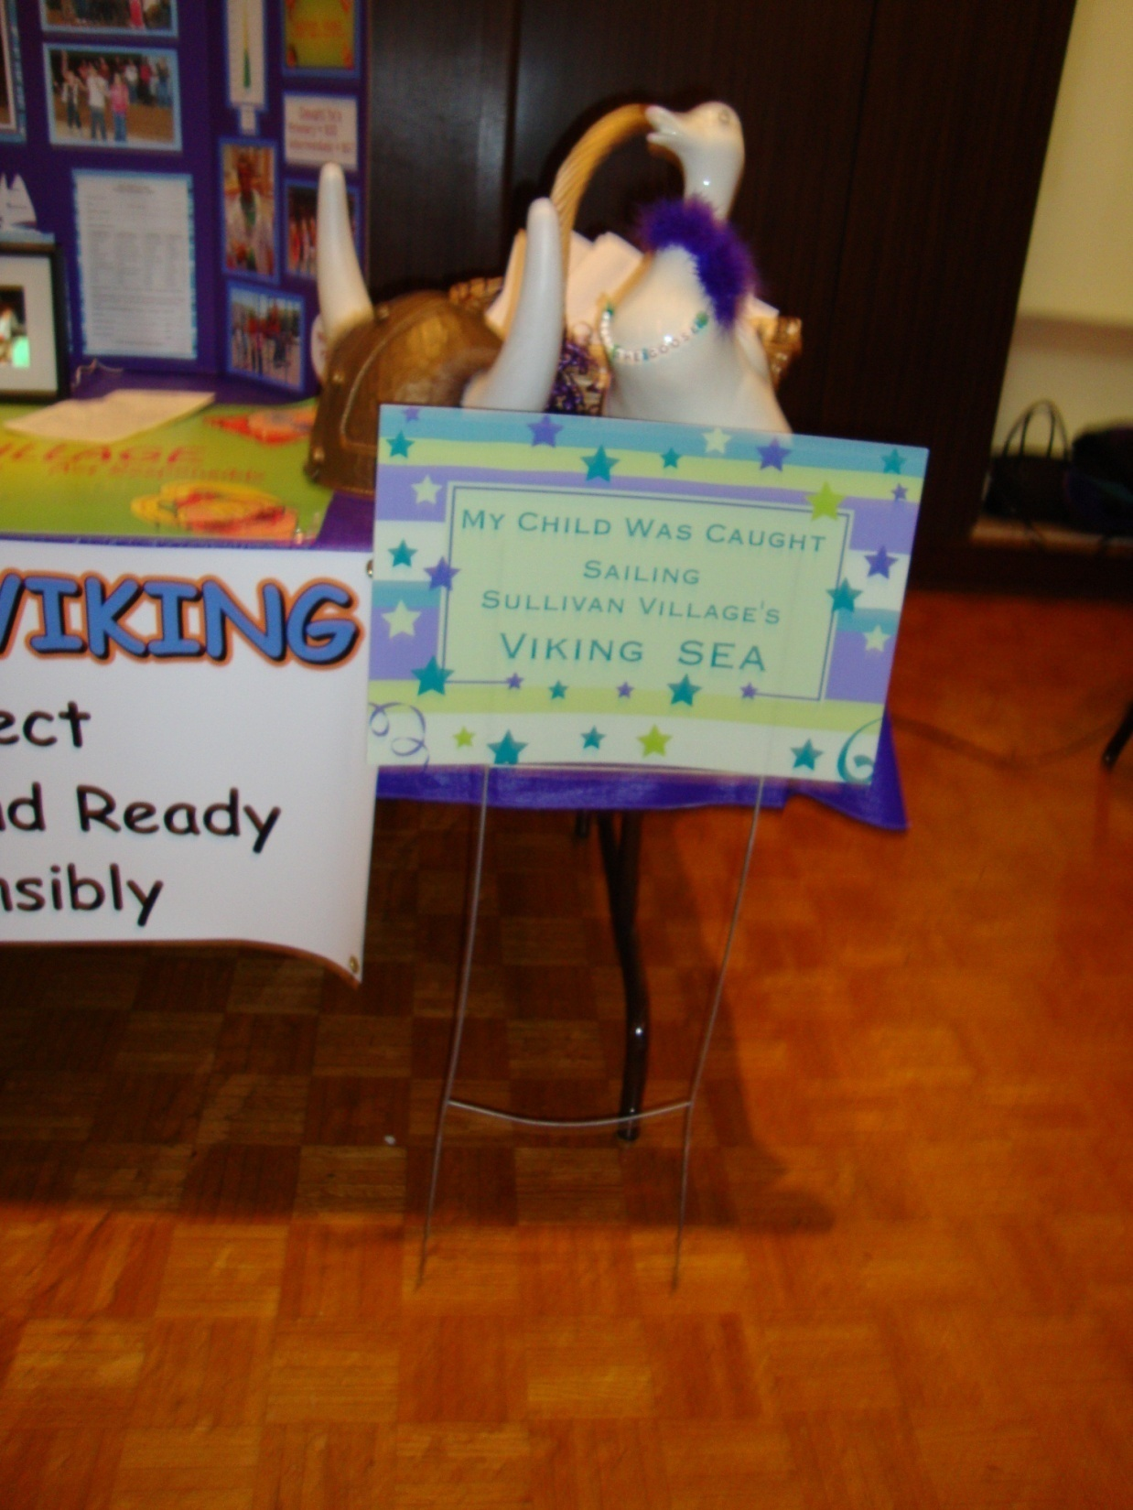
©BDS
Yard Sign for One Week

Slide 32
Classroom with the most gotchas gets a lighted entrance.

Slide 33
Get a giant poster of yourself printed by national guard.

Slide 34
Special seating in the lunchroom.

Slide 35
Dress up and sit at special table at lunch- red carpet treatment.

Slide 36
Sign the Golden book of greatness

Slide 37
Use photo effects and stylize a picture and place in front hall.

Slide 38
Leadership

Slide 39
www.pbisvideos.com

Slide 40
Assistant Principal for the day
Honorary
Assistant
Principal

Slide 41
Be the line leader

Slide 42
Student Leadership Team

Slide 43
Get to design posters for the school’s pbis program.

Slide 44
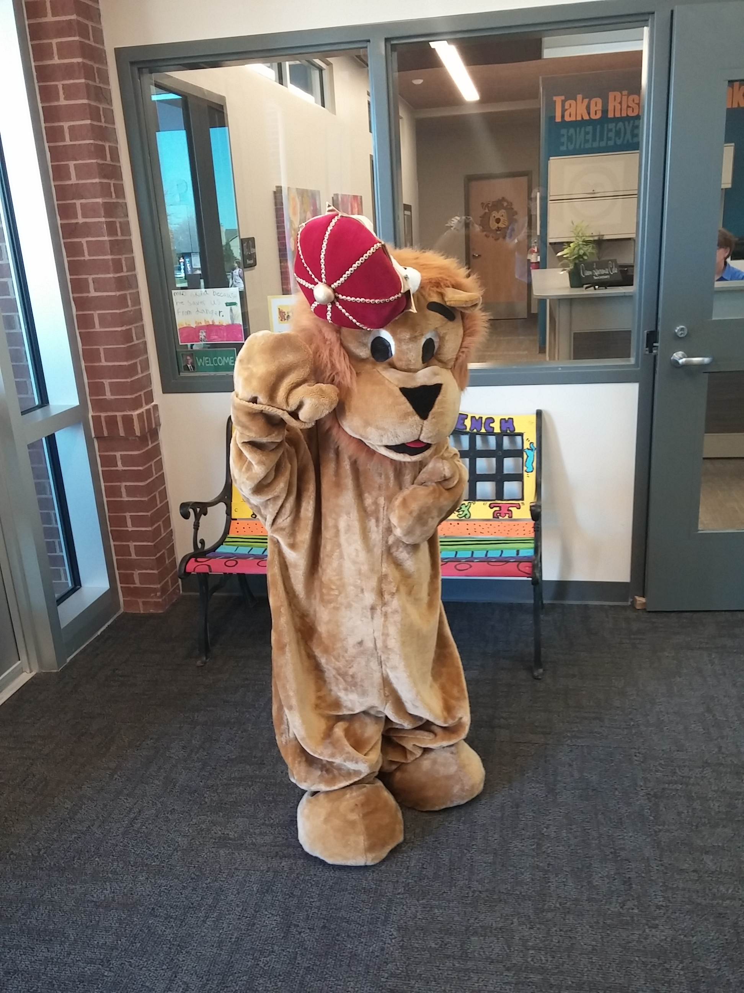
Get to wear the student mascot during assembly and lead cheers
Regency Place Elementary- Olathe, KS

Slide 45
Broadcast the morning school news

Slide 46
Praise

Slide 47
Invitation to special breakfast of recognition and food.

Slide 48
Class with the most gotchas gets bragging rights.

Slide 49
Get to decorate a bulletin board square with your artwork- name over intercom with reason for earning gotcha.

Slide 50
Assistance

Slide 51
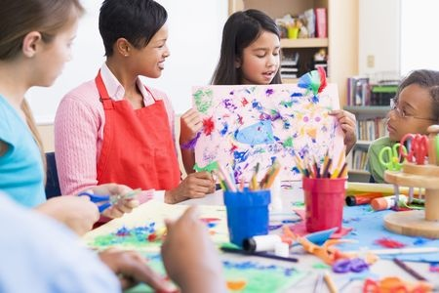
Learn an art skill

Slide 52
Computer coding skills

Slide 53
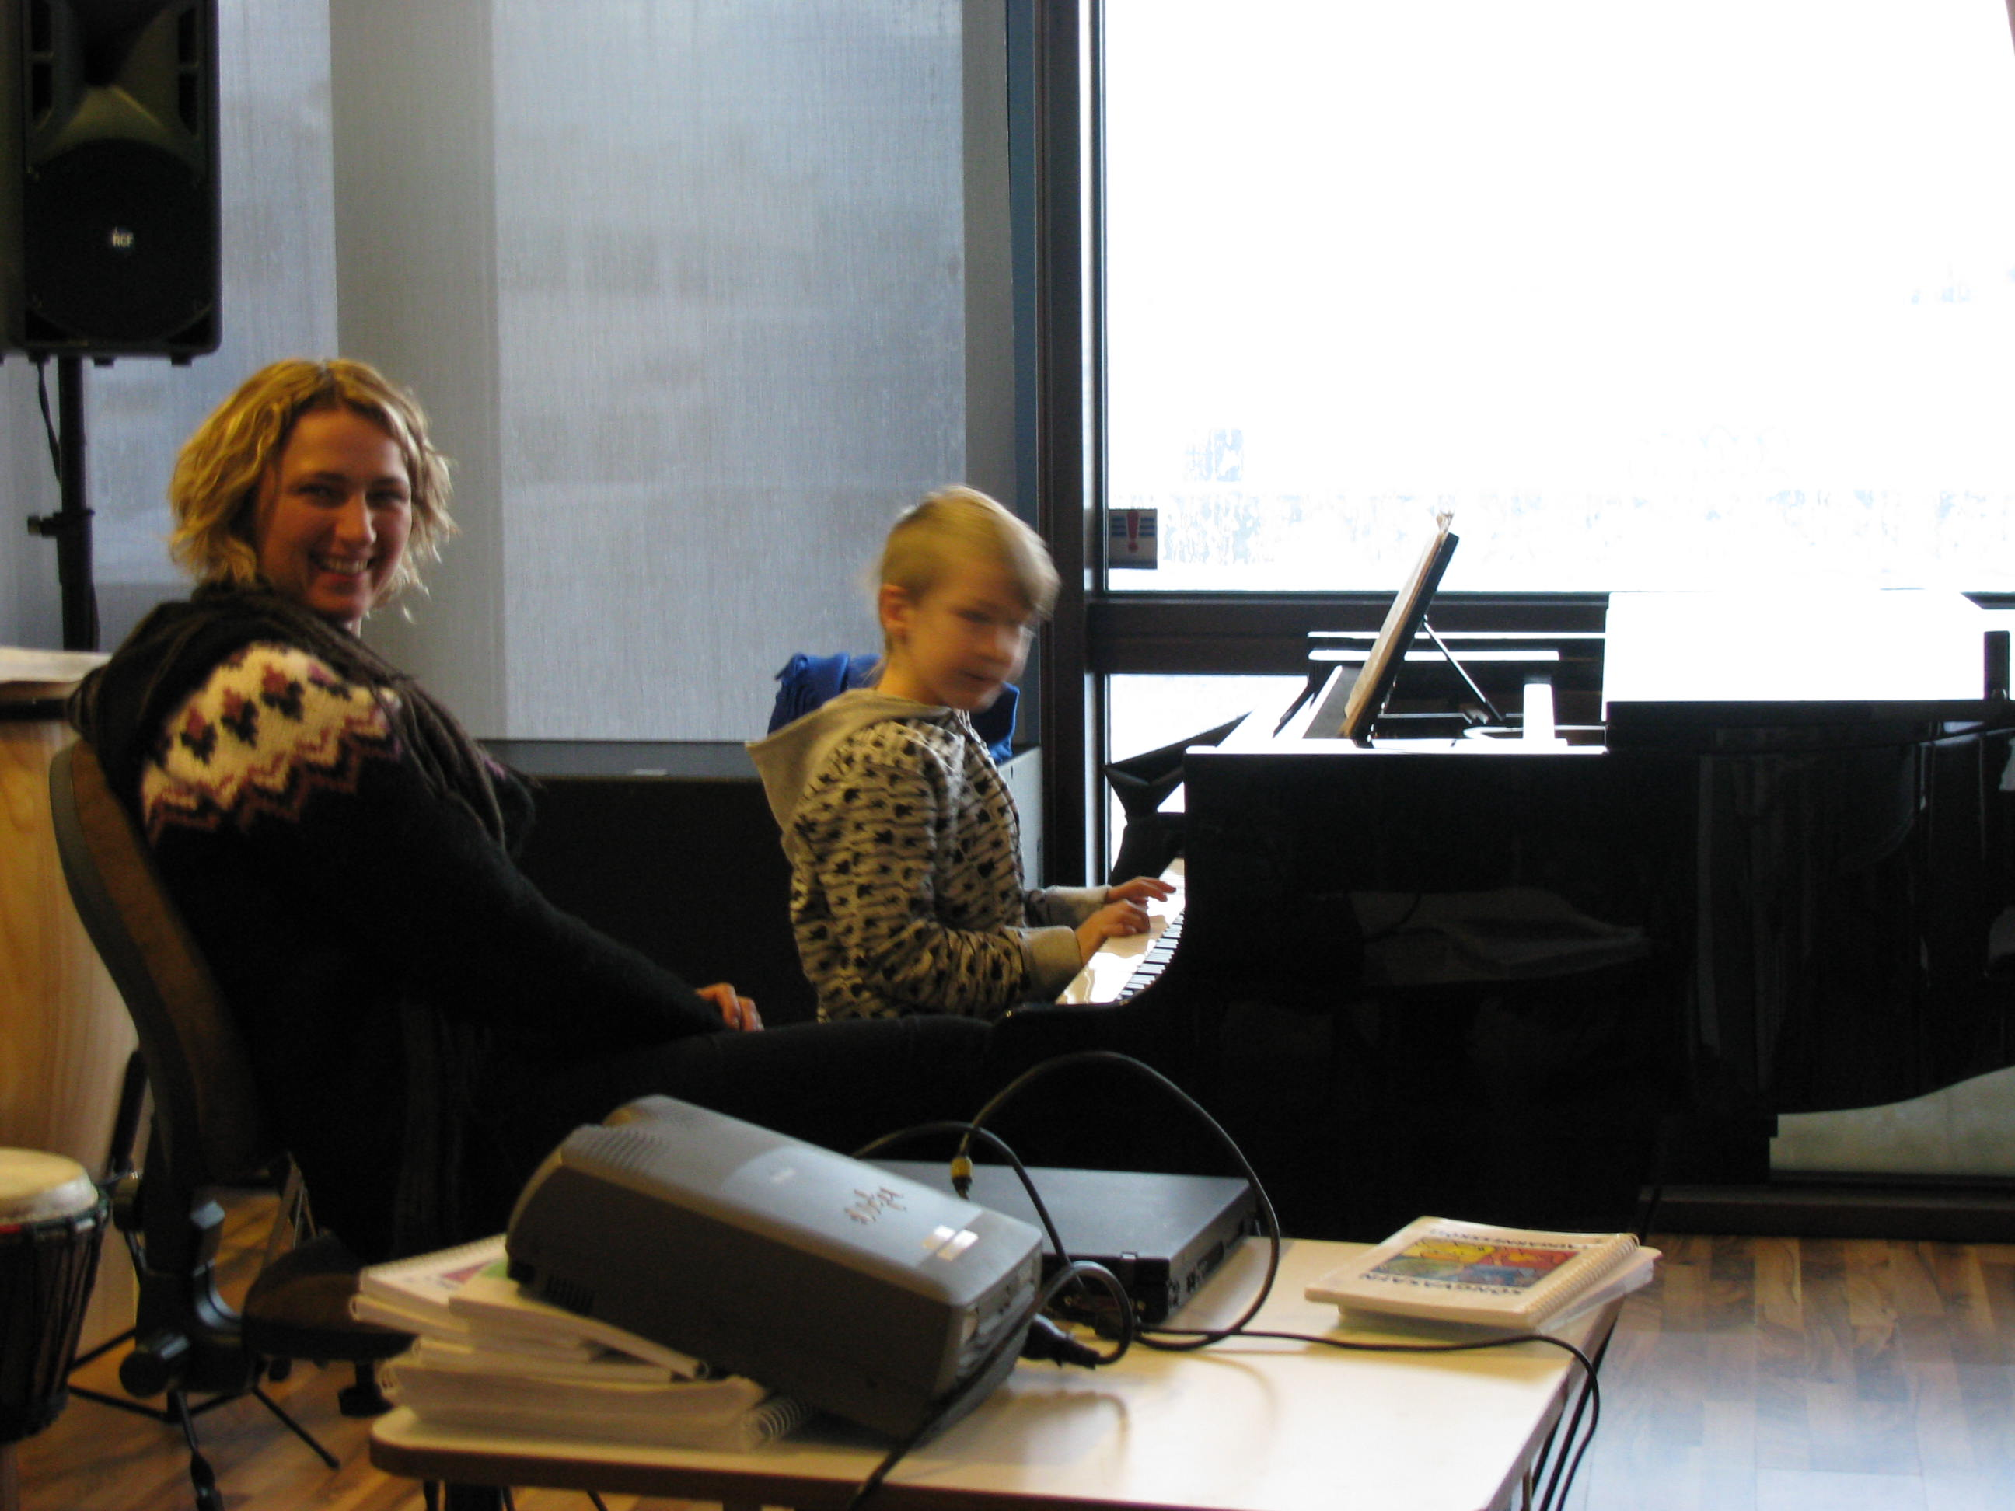
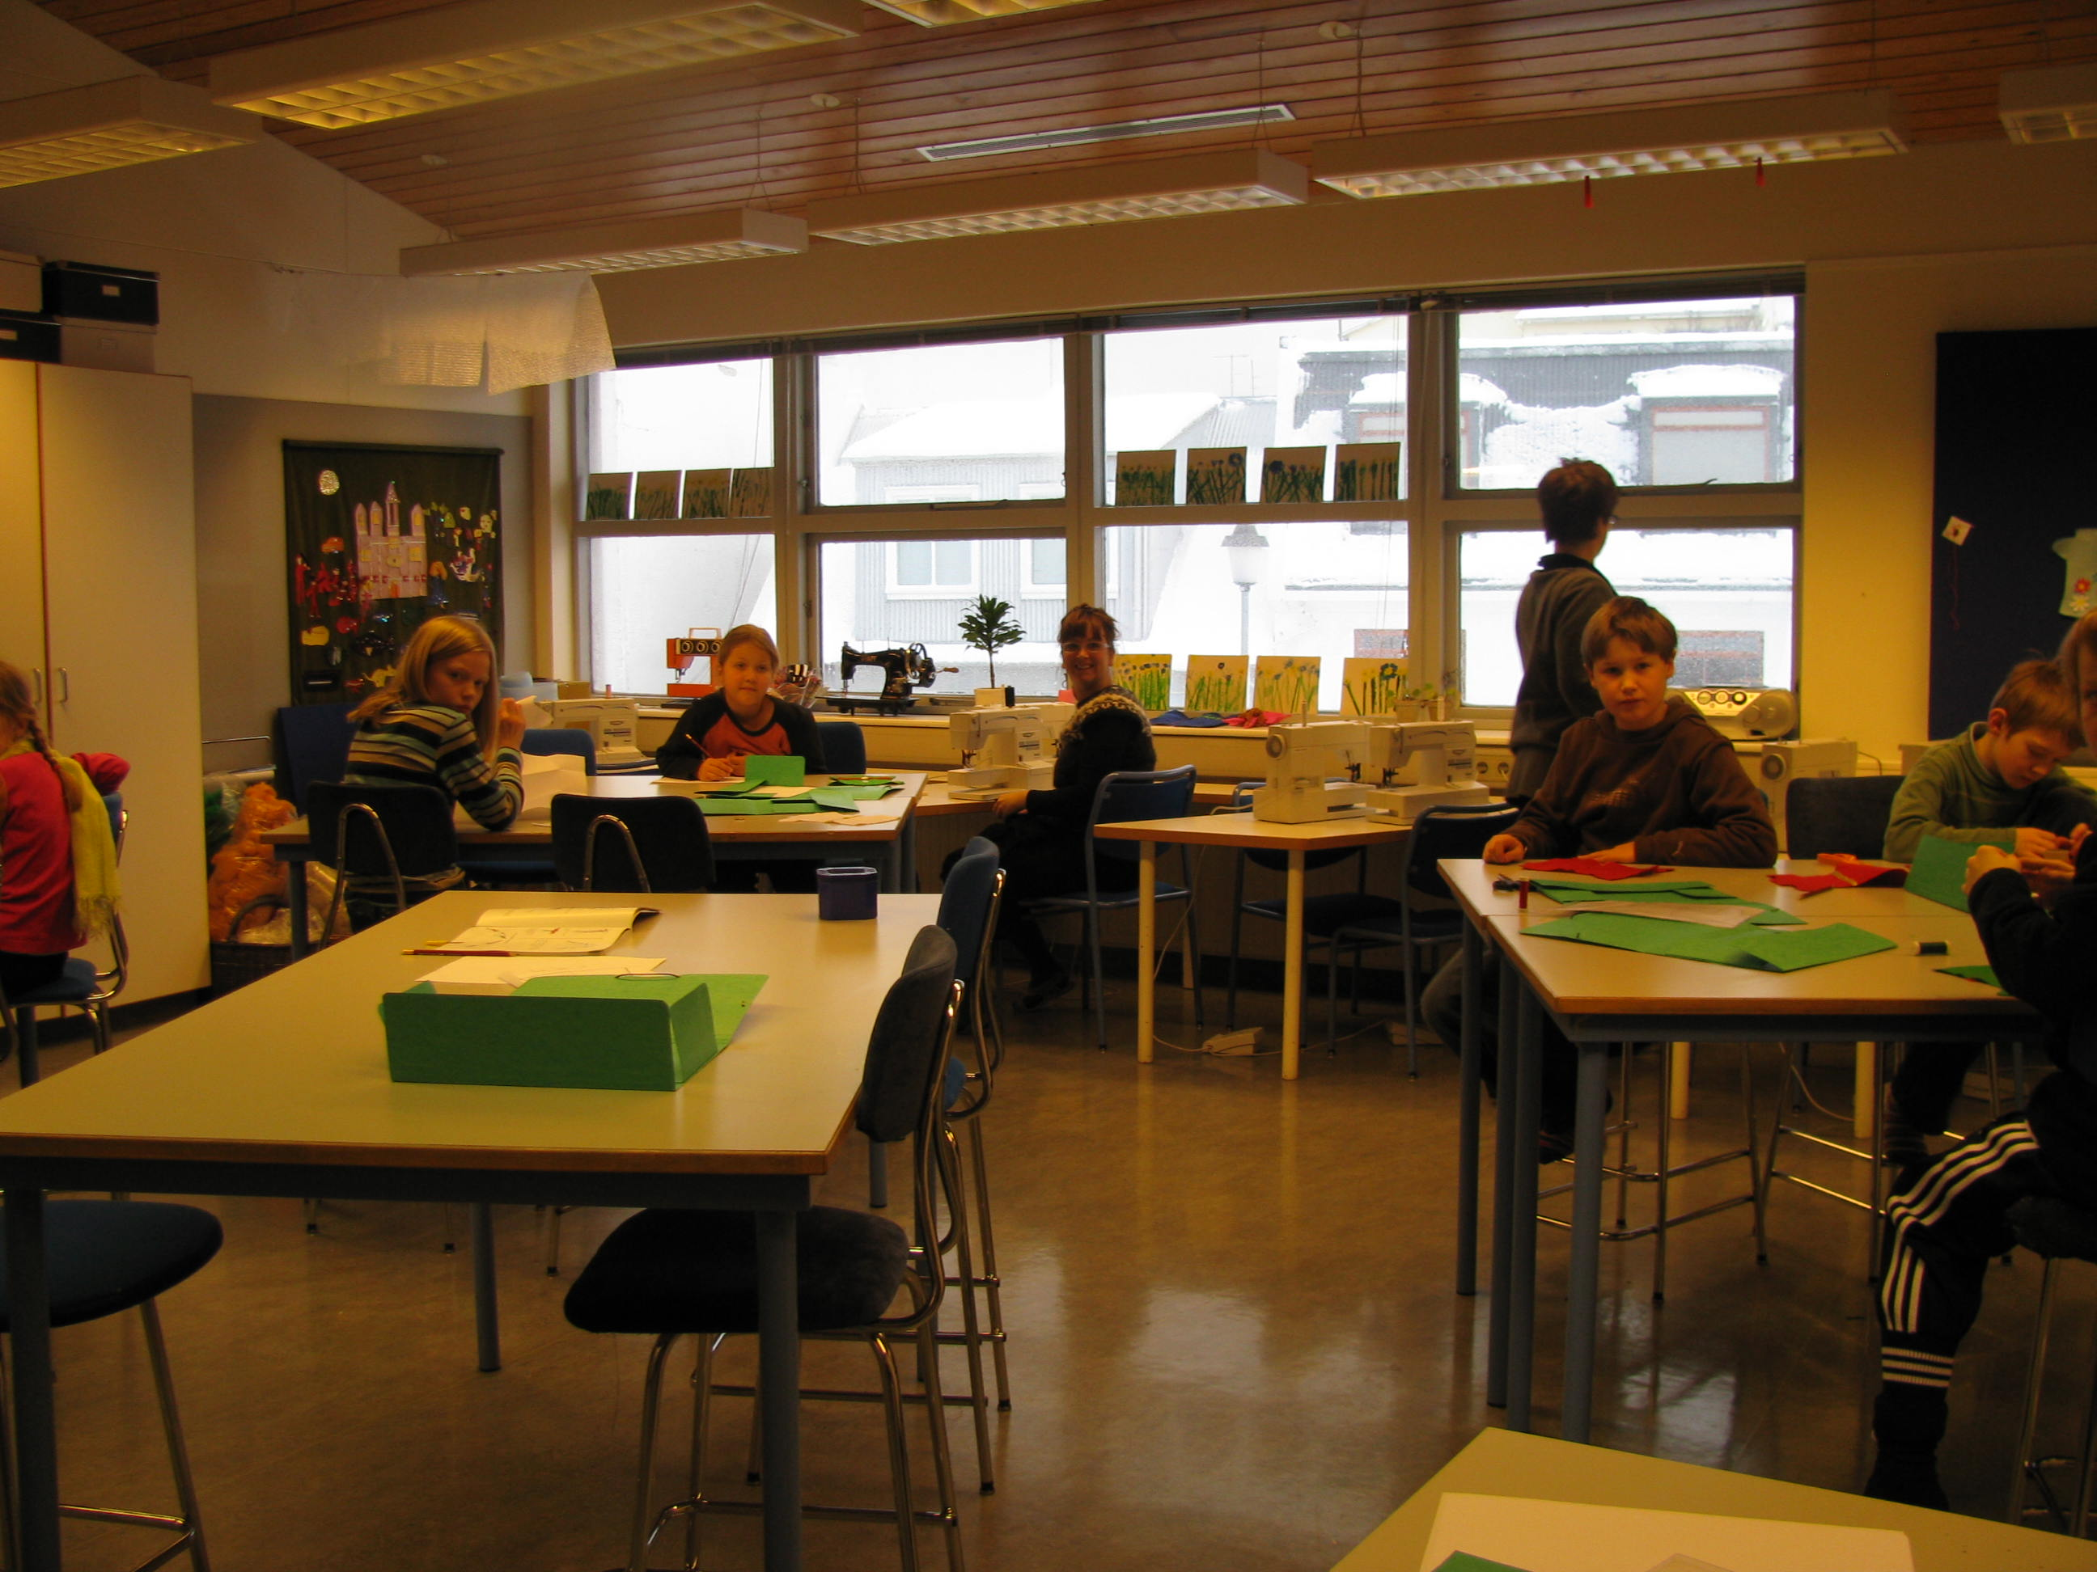
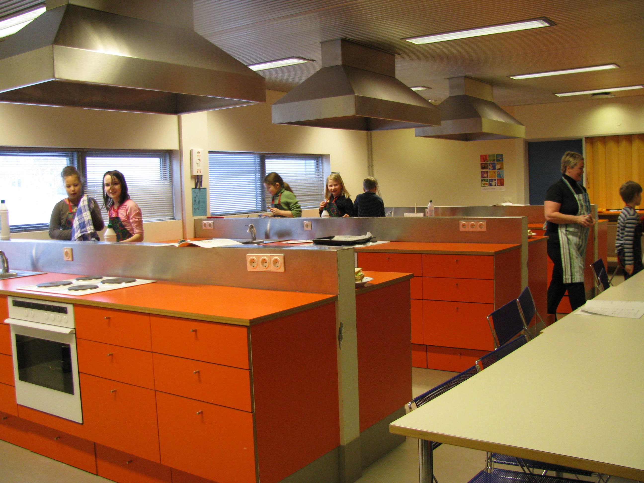
Piano-cooking-woodworking-sewing

Slide 54
touch

Slide 55
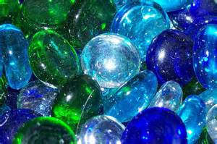
Queen of bling and sparkle visits your homeroom and gives dragon tear.
Middle School Students caught being kind at Santa Fe Trail Middle School- Kelly Ralston- Assistant Principal.

Slide 56
Get your face painted to match the principal

Slide 57
Revision of the Environment Pages 10-11
Biggest Return on Investment
Allday & Pakurar (2007) found teachers who greet students at the door enjoy 45-72% less disruptions in the classroom
We researched what components make up a connection with a student:
Touch
U se of name in a positive way
Making eye contact
Smiling
T
U
M
S

Slide 58
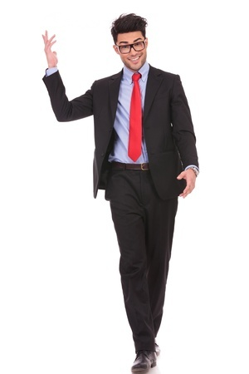
Use their name in a positive way.
Hey Slugger! How’s it going?
I wish I got in trouble more so you knew my name.

Slide 59
Make Eye Contact
72% of teens say their main mode of communication is texting.
Everyone is looking at a screen.
Hungry for eyeballs.

Slide 60
TUMS your Neighbor Now
Biggest Return on Investment
Allday & Pakurar (2007) found teachers who greet students at the door enjoy 45-72% less disruptions in the classroom
We researched what components make up a connection with a student:
Touch
U se of name in a positive way
Making eye contact
Smiling
!
T
U
M
S

Slide 61
escape

Slide 62
Exempt from certain tests with 100% attendance and GPA

Slide 63
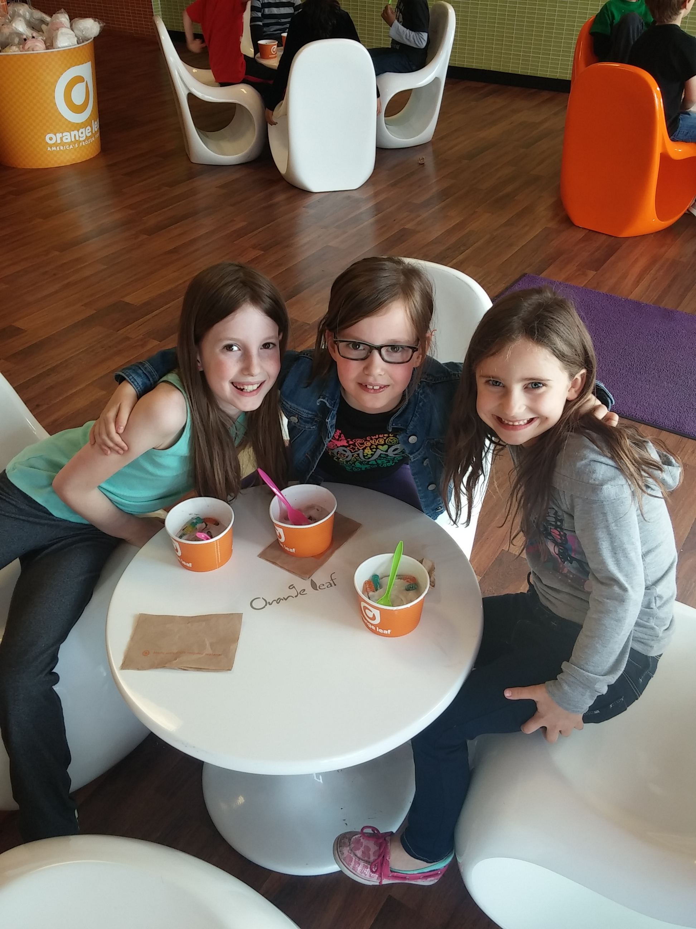
Get to leave school and go with principal to orange leaf frozen yogurt.
Regency Place Elementary- Olathe, KS

Slide 64
Get to leave school and go visit a hospital and learn about it.

Slide 65
Homework free pass for one assignment

Slide 66
Name the teacher- Name the Dance
©BDS

Slide 67
supplies

Slide 68
She received 30 air filled disks for chairs two weeks after her request on www.Donorschoose.org
Franklin Elementary- Cape Girardeau, Missouri

Slide 69
Cash in gotchas to get your chair decked out- air filled disk, cover, and therapy banding for your feet.

Slide 70
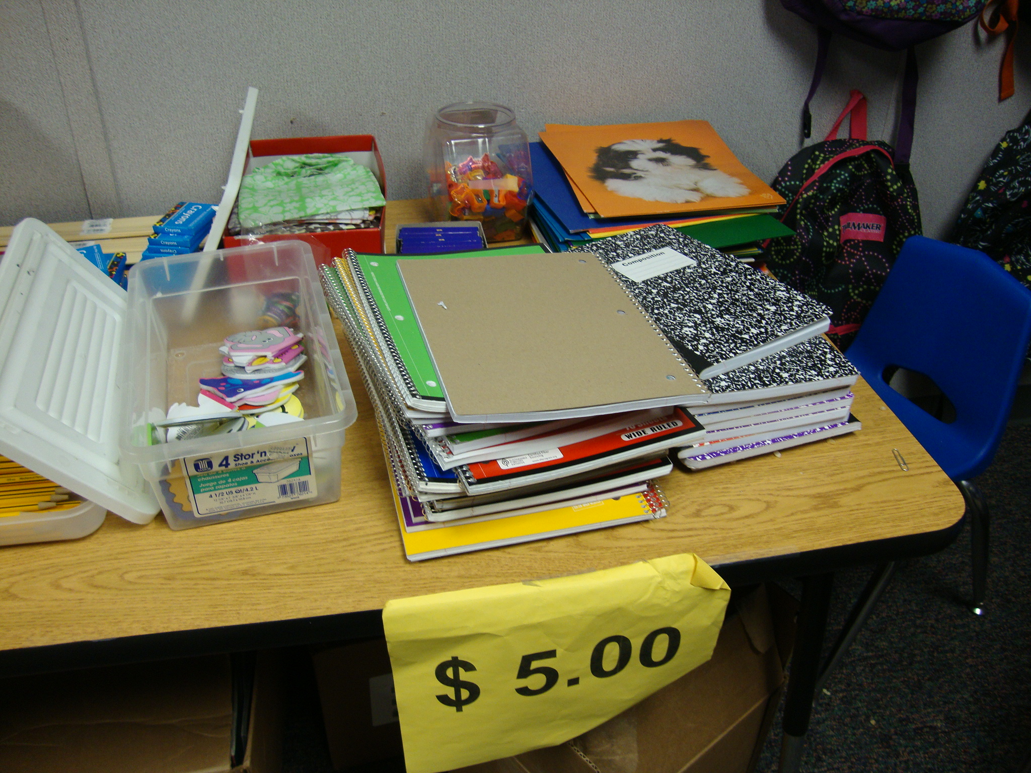
School supplies- for gotchas

Slide 71
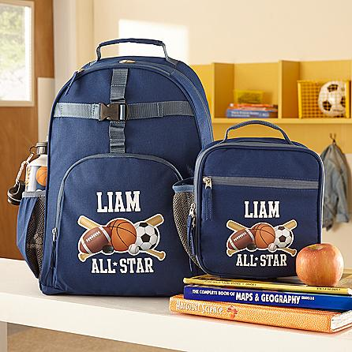
Get a volunteer to come monogram backpacks with cricut iron-on vinyl or an embroidery machine.

Slide 72
Palpates-
1) Privileges (Earning special privileges)
2) Attention (Quality Time with Adults and Peers)
3) Leadership (Earning Leadership Roles)
4) Praise (Social Praise- Name in Lights)
5) Assistance (Special Assistance in a Topic of Their Choice)
6) Touch (High Five)
7) Escape (Escape from a Task or Chore)
8) Supplies (School Supplies)

Slide 73
Whole school ideas

Slide 74
We have to make it more fun to do the right behavior…….

Slide 75
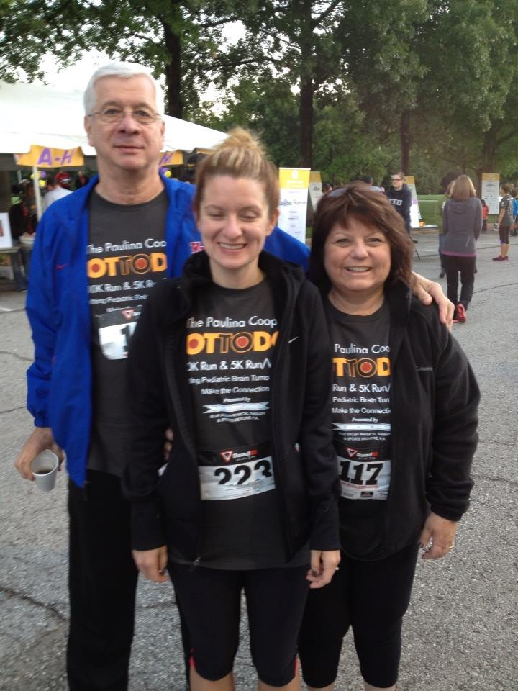
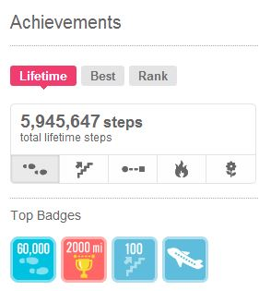
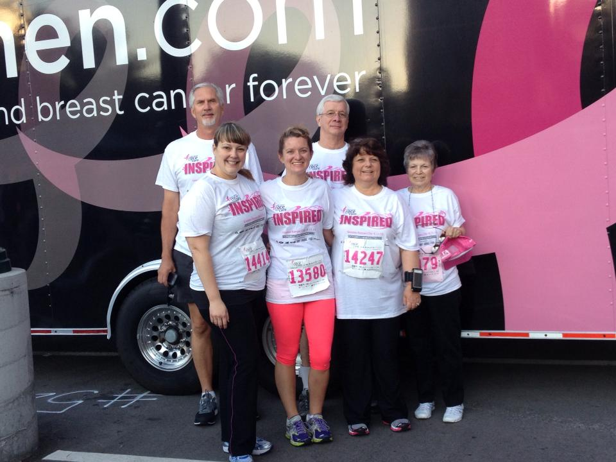
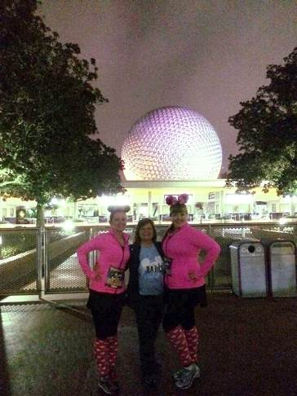
www.fitbit.com – More Fun
Dot Trot (Thanksgiving)
Fourth of July
Disney Marathon Weekend
Mother’s Day- Breast Cancer

Slide 76
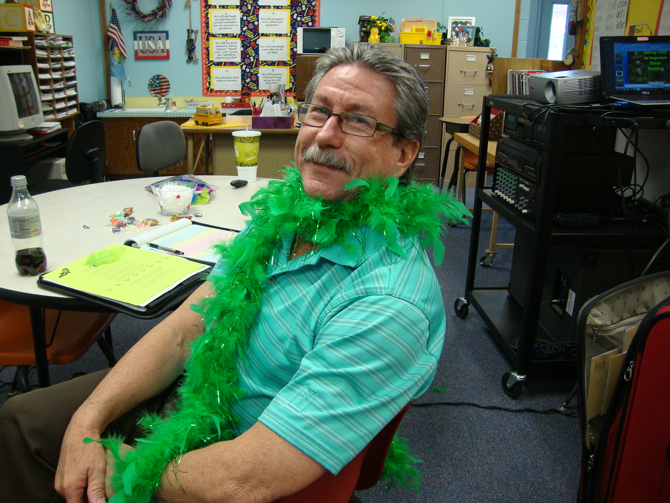
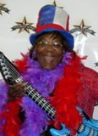
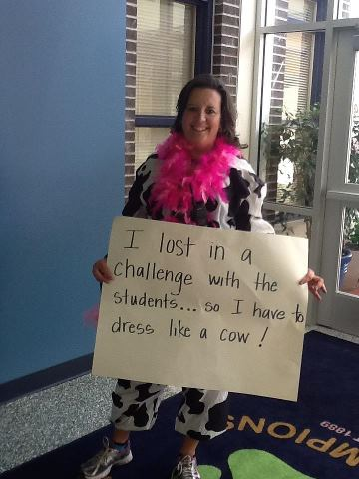
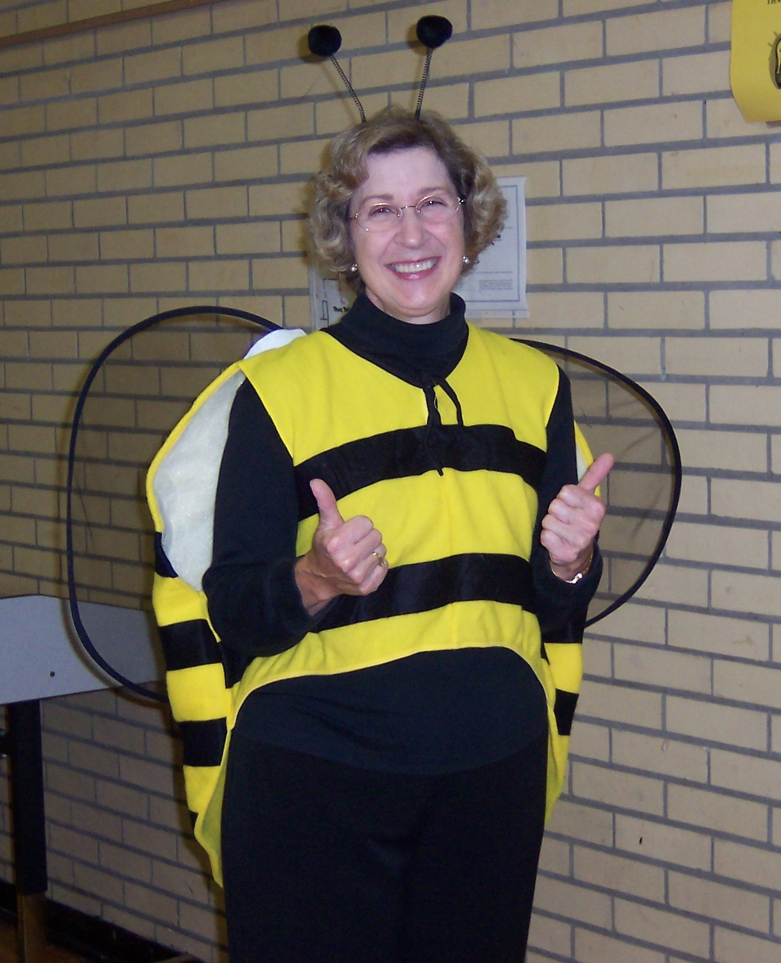
Whole school challenge- see the principal dressed in a fun costume for the day.

Slide 77
Double gotcha day- when all staff wear their school shirts

Slide 78
Triplicate gotchas

Slide 79
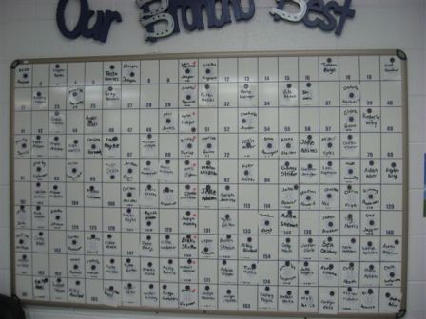
Principal drawing yellow copy

Slide 80
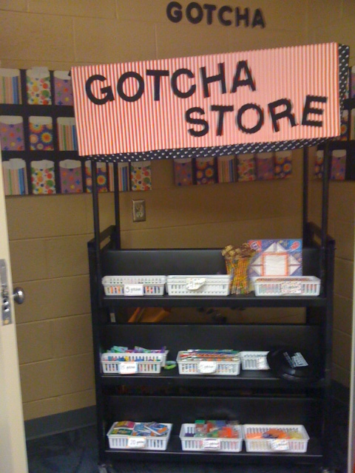
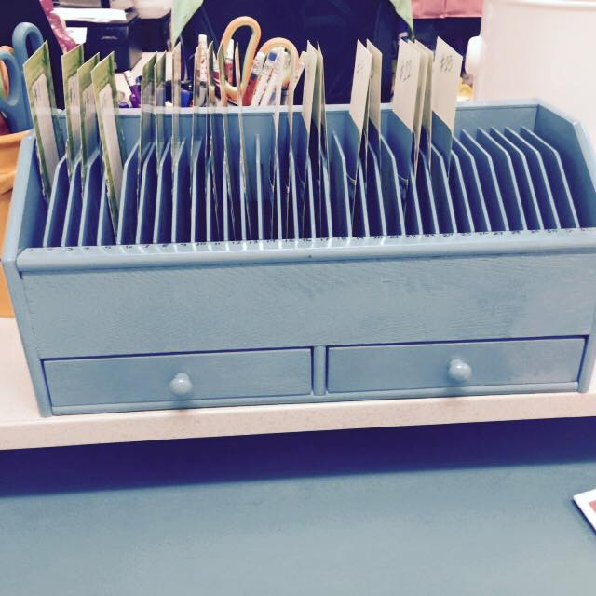
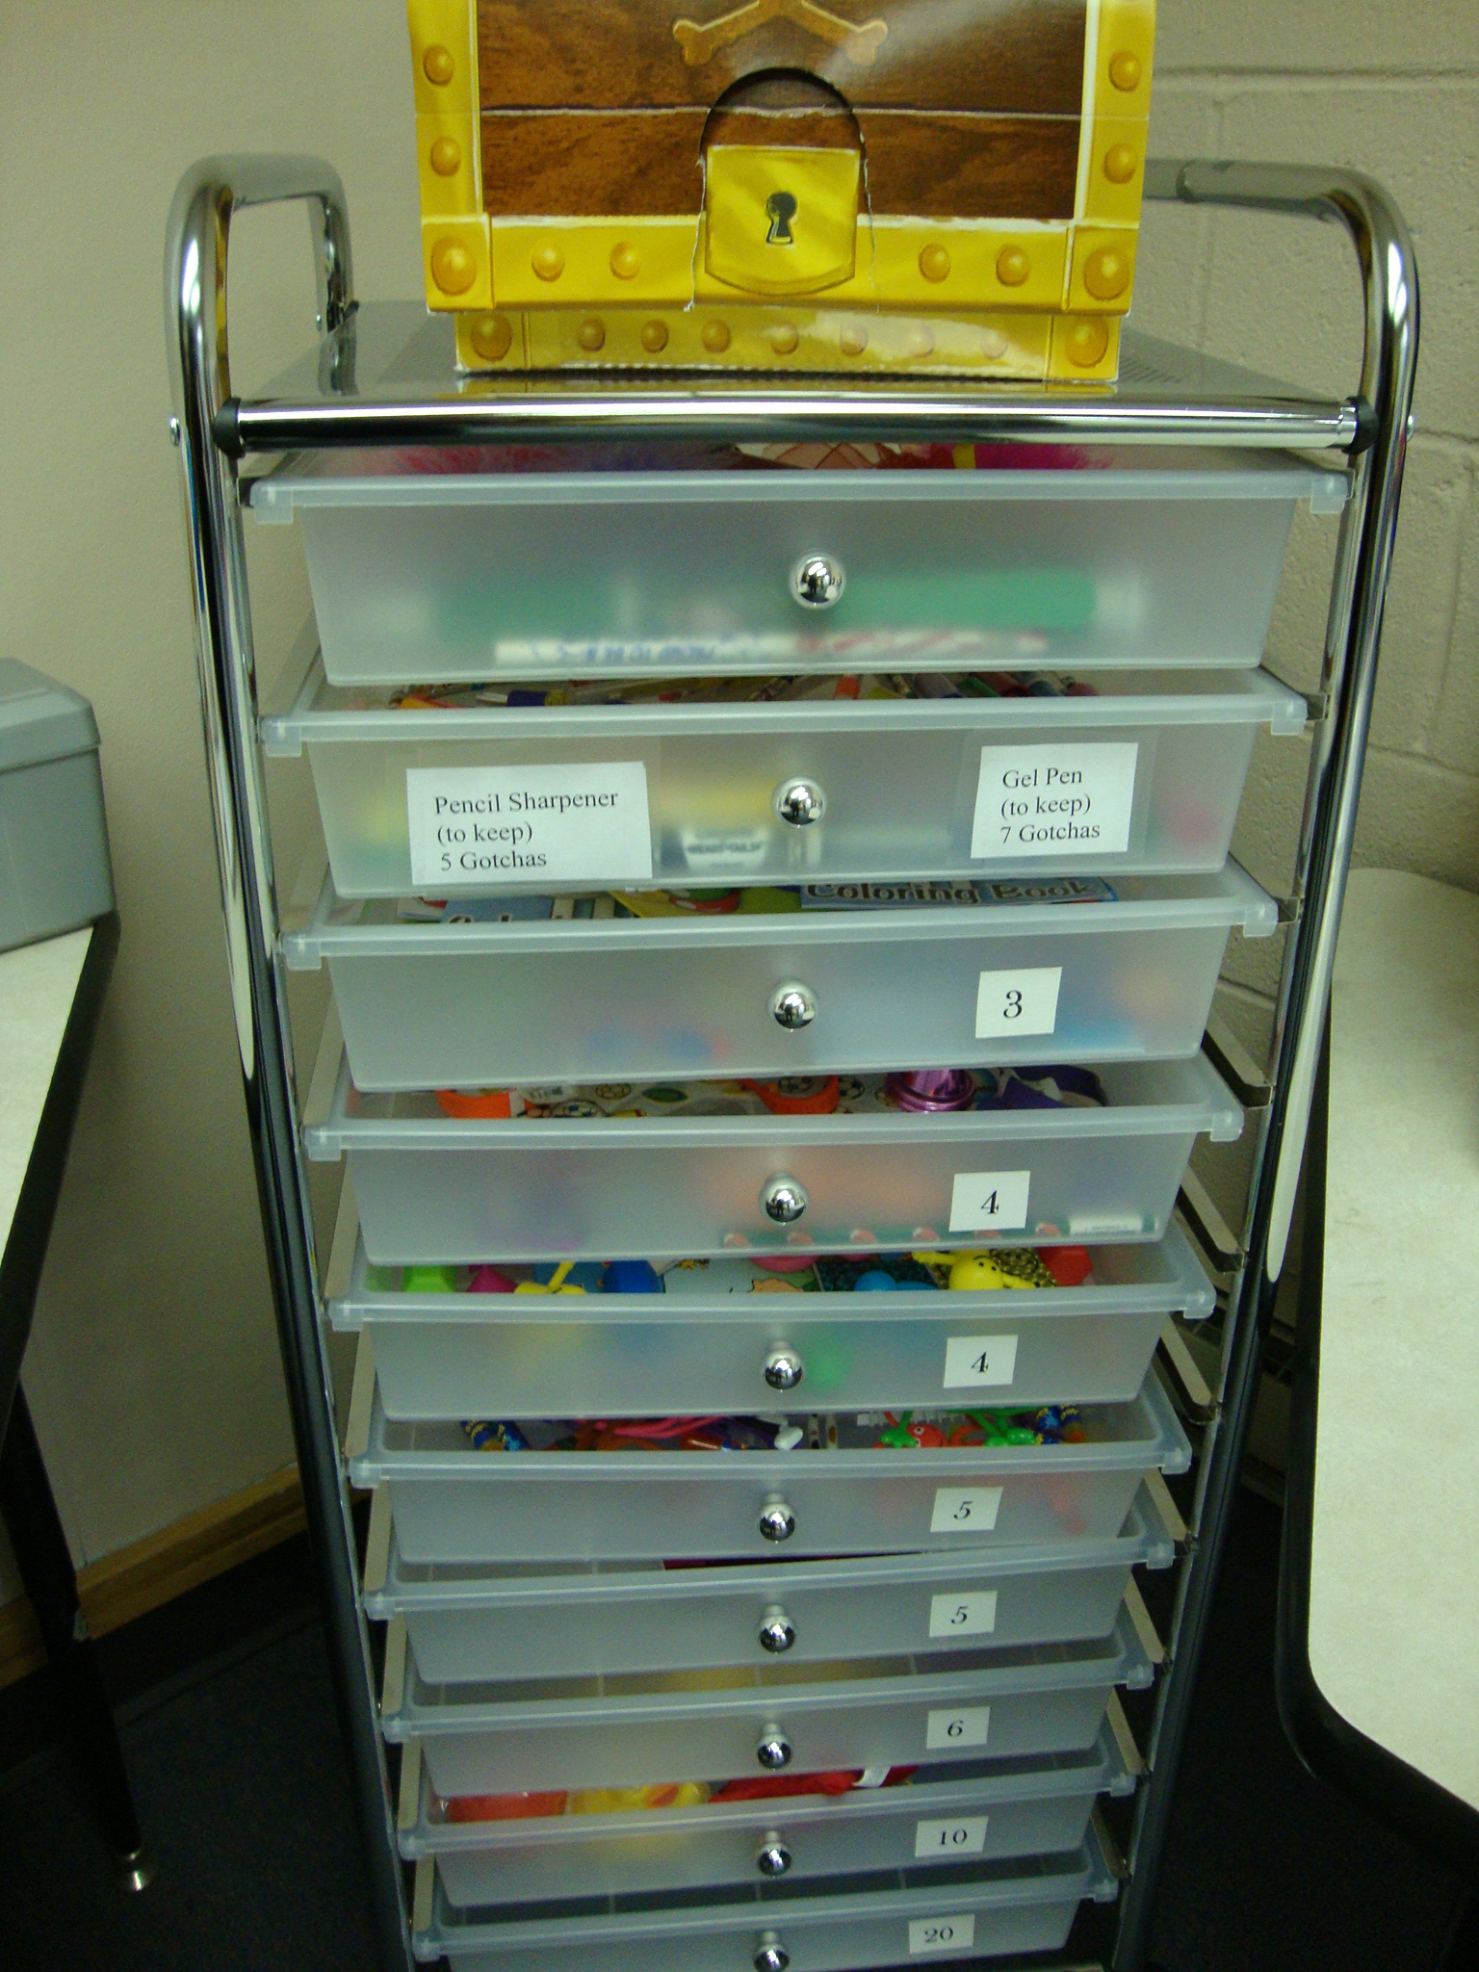
Pink copy- banked

Slide 81
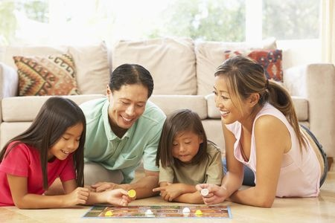
White copy- parents’ reinforcement

Slide 82
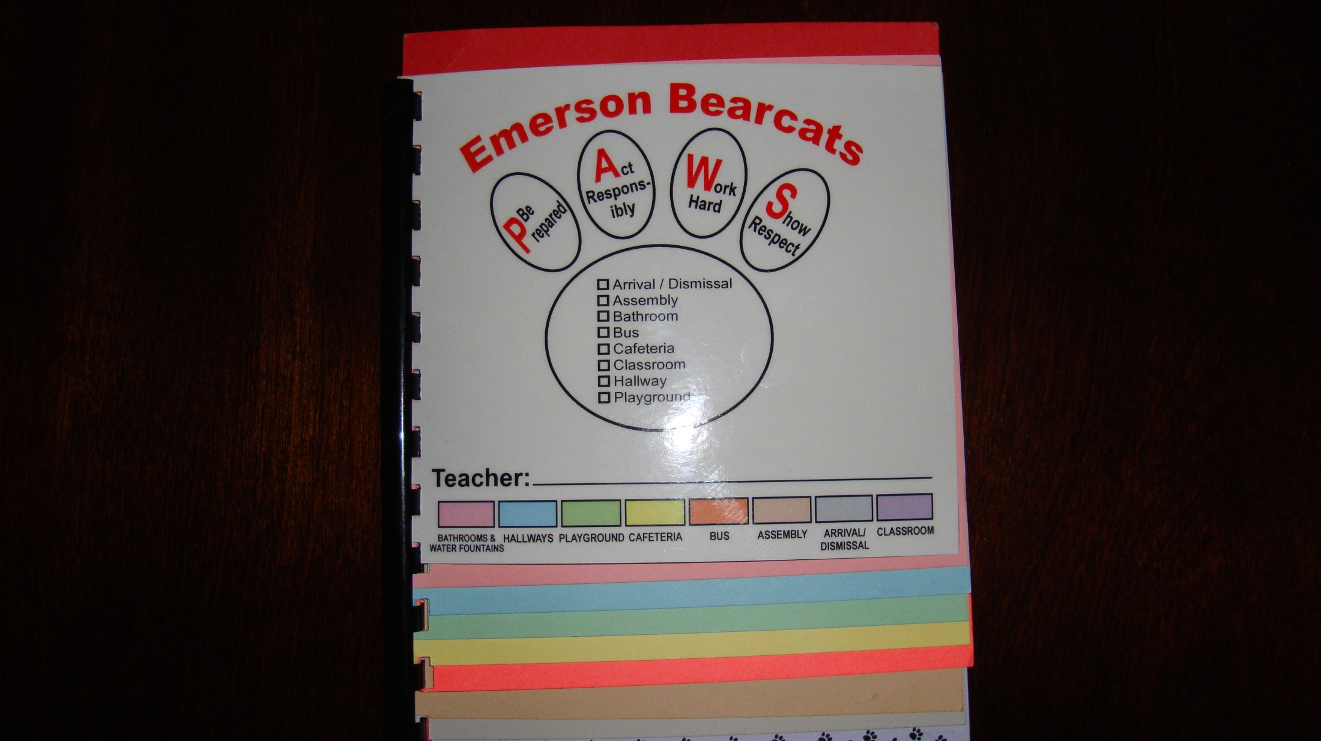

Slide 83
Selling Staff

Slide 84
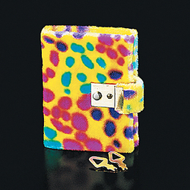
Journals
Start a journal for all staff: (one way)
Compliment a staff member and put the journal in their box.
They have 24 hours to read it and write a compliment about someone else on the staff and put it in that member’s mailbox.
Have to compliment someone who hasn’t had a compliment until it goes all the way around.
Start all over.

Slide 85
Dear Diary
November 21, 2008
I’d like to compliment Daisy Doodle. Daisy is always the first one out to the car lot to help the car riders get out of the cars in the morning and the last one to leave at the end of the day after the last little car rider gets in the car. She greets everyone with a smile and wears a funny hat on Friday just to cheer everyone up. The parents always look forward to seeing Daisy in the car lot.
Signed,
Phil Goode

Slide 86
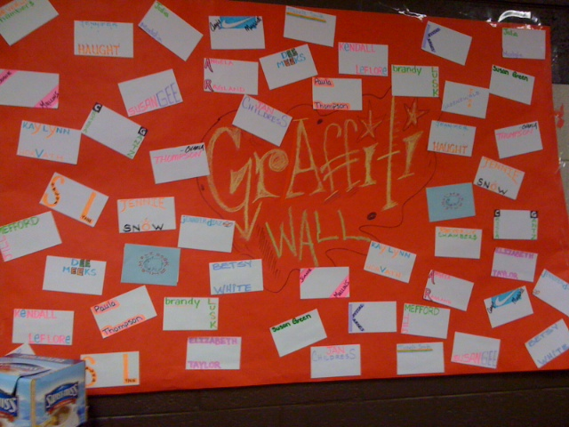
Graffiti Wall with positive adult comments
Notes:
Liberty Elementary- Sapulpa, Oklahoma

Slide 87
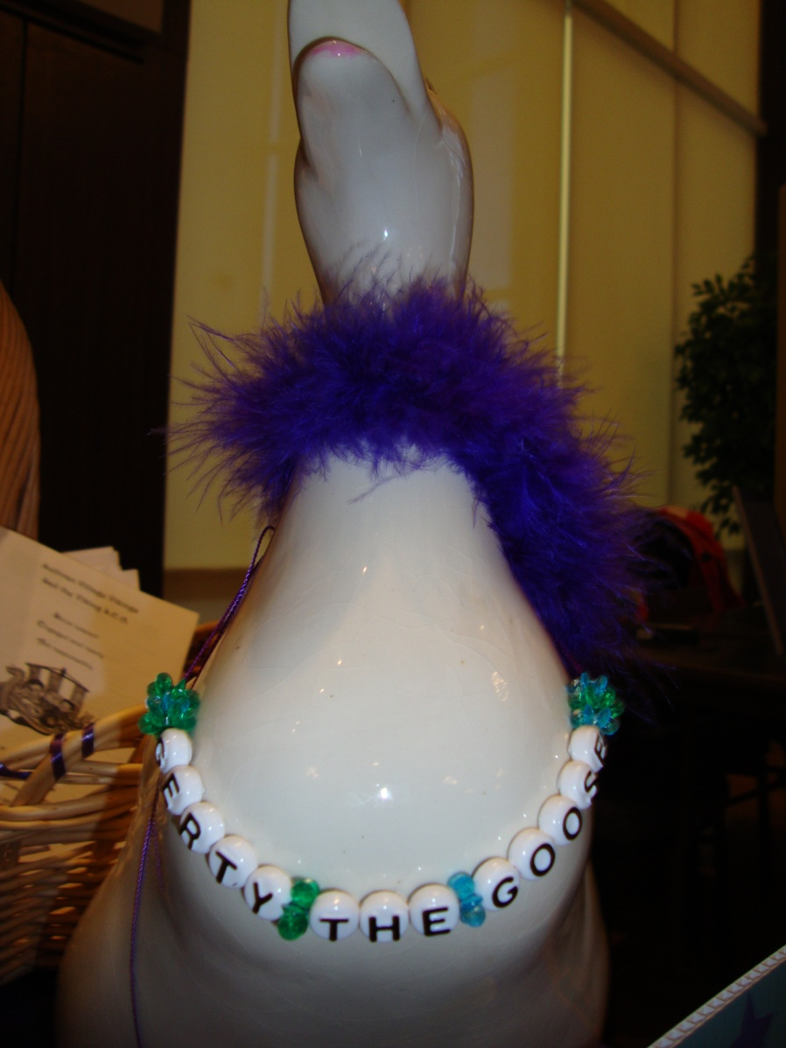
G.O.O.S.E THE STAFF
Notes:
Here’s the goose – you can purchase them in many novelty stores.- GOOSE stands for Get Out Of School Early

Slide 88
GOOSE or SIT
Notes:
SIT stands for Sleep in Today

Slide 89
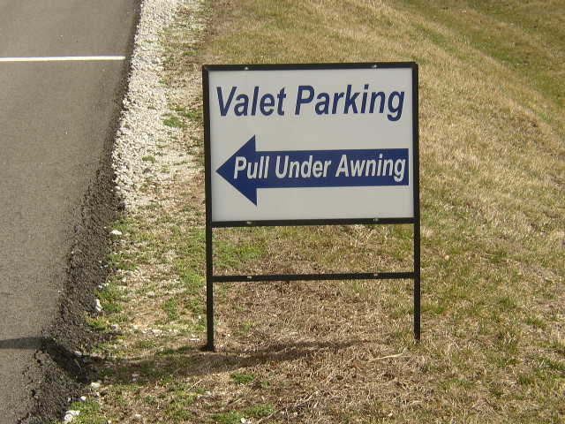
Transportation
Adult transportation winners
Special parking in front of the school
Valet parking
Coupon for one of the following:
Leave school early one day
Free snack from vending machine
Goody bag with pens, pencils, sticky notes etc.
Wear jeans on another day
Valet Parking
Tammy Bilson ….come on in. You’re the next contestant in the “gotcha” was great.
Notes:
Imagine pulling up to school in the morning and having free valet service for yourself. The principal at one school valet parks a staff member’s car each morning. They never know who it will be until they get to school. How fun is that?

Slide 90
Special Parking Privileges
Notes:
Ash Street Center in Jonesboro, Georgia has two special parking spots for the staff member of the week. It’s the parking spot closest to the door ☺

Slide 91
Weatherford High School- smack their teachers with a KISS award- they get one class period covered by the assistant principal
Notes:
Weatherford High School- smack their teachers with a KISS award- they get one class period covered by the assistant principal

Slide 92
Make it easy to catch kids being good

Slide 93
Google Docs- Emails Principal when teachers add any data.

Slide 94
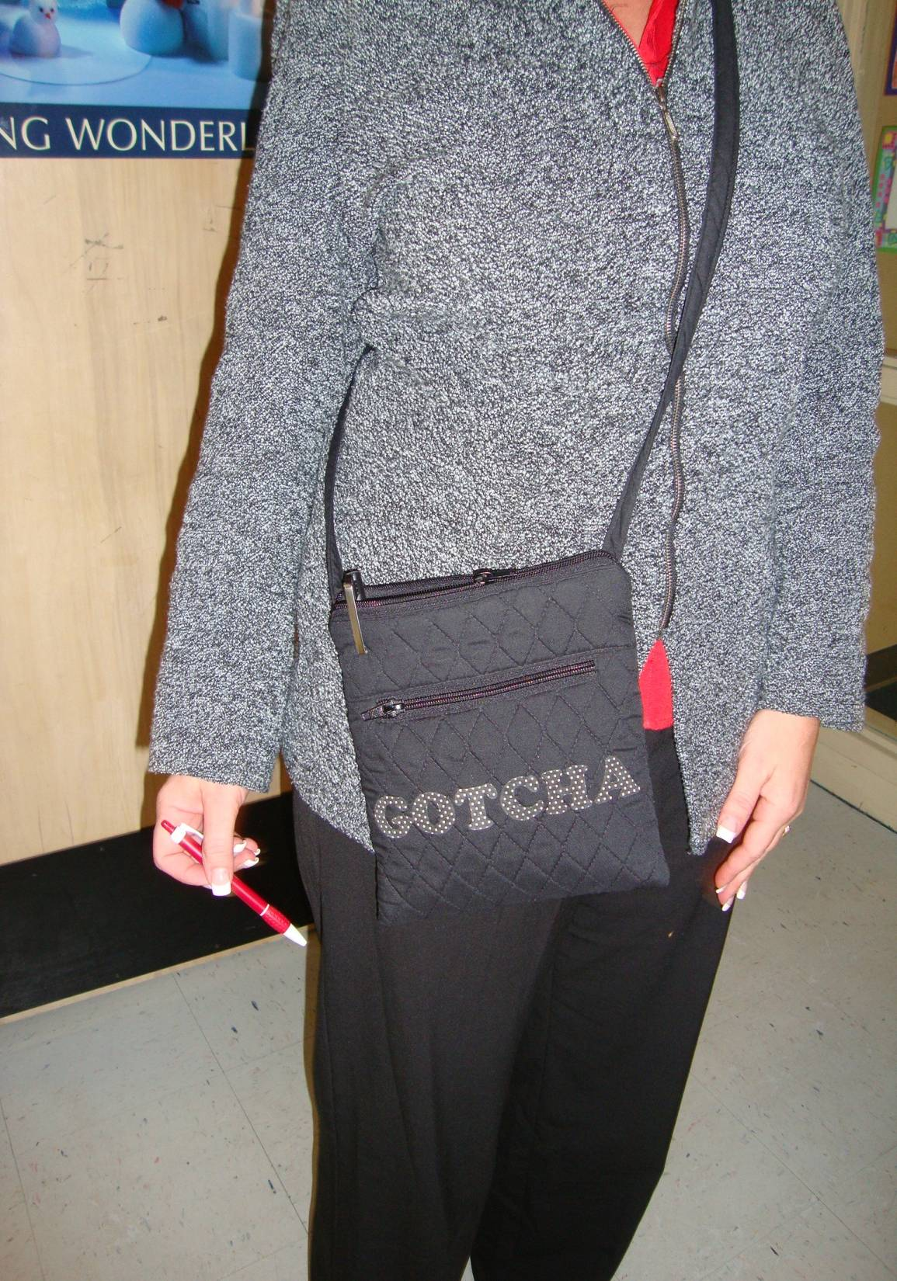

Slide 95
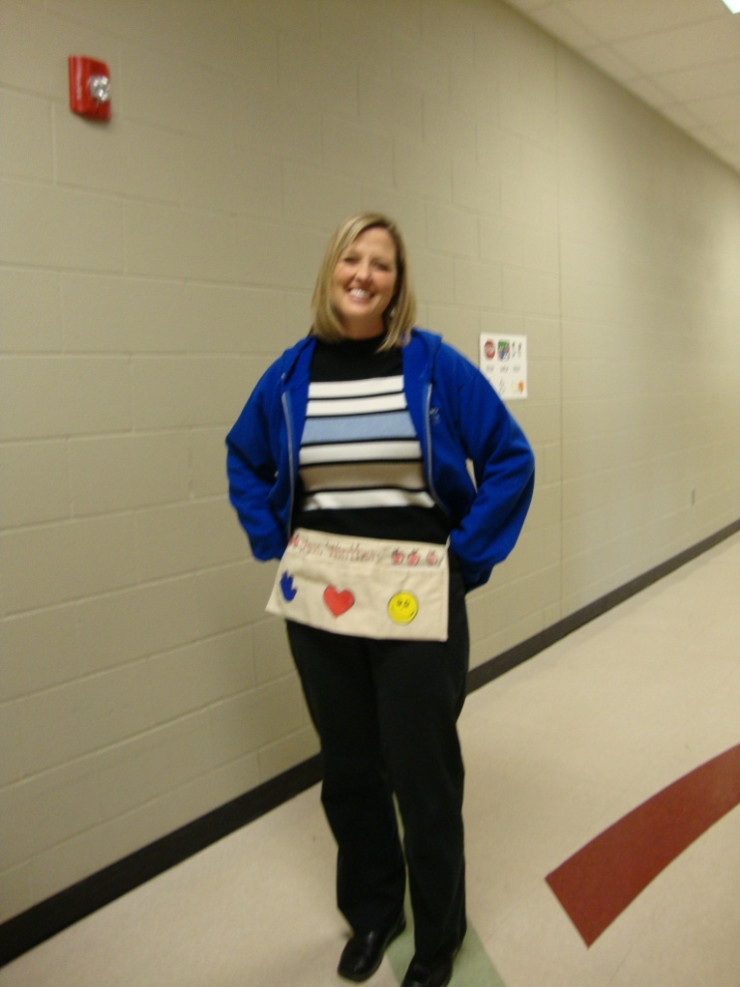
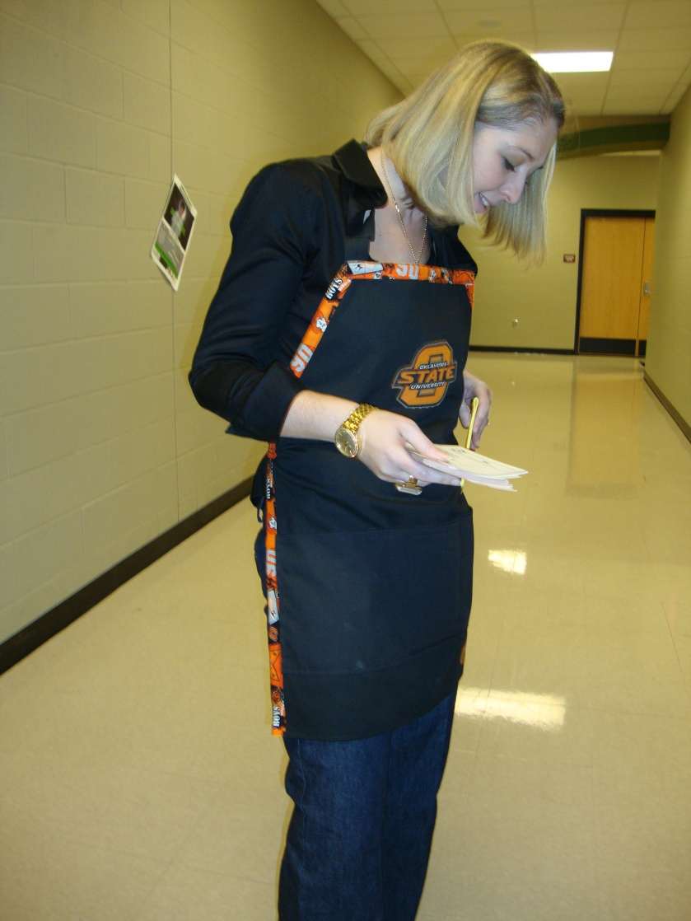

Slide 96
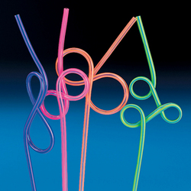
YOU help quench kids thirst for knowledge by….
Or….we are crazy about the way you……

Slide 97
You’re Fanta-stic

Slide 98
We know you enjoy your job to the MAXX

Slide 99
We “MIST” you- when someone is gone.

Slide 100
Some Monday Morning Give Everyone an extra Boost

Slide 101
The “dog” ate my homework……. An eagle came down and turned off my alarm clock.

Slide 102
Failure is not an option…………………….

Slide 103
……Helping Kids Connect the Dots……

Slide 104
We all need a spoonful of sugar from time to time….

Slide 105
For those times when someone had thick skin……

Slide 106
When you have a planning meeting

Slide 107
During CRCT’s.

Slide 108
Dollar Tree- Garden Kneeling Pad.

Slide 109
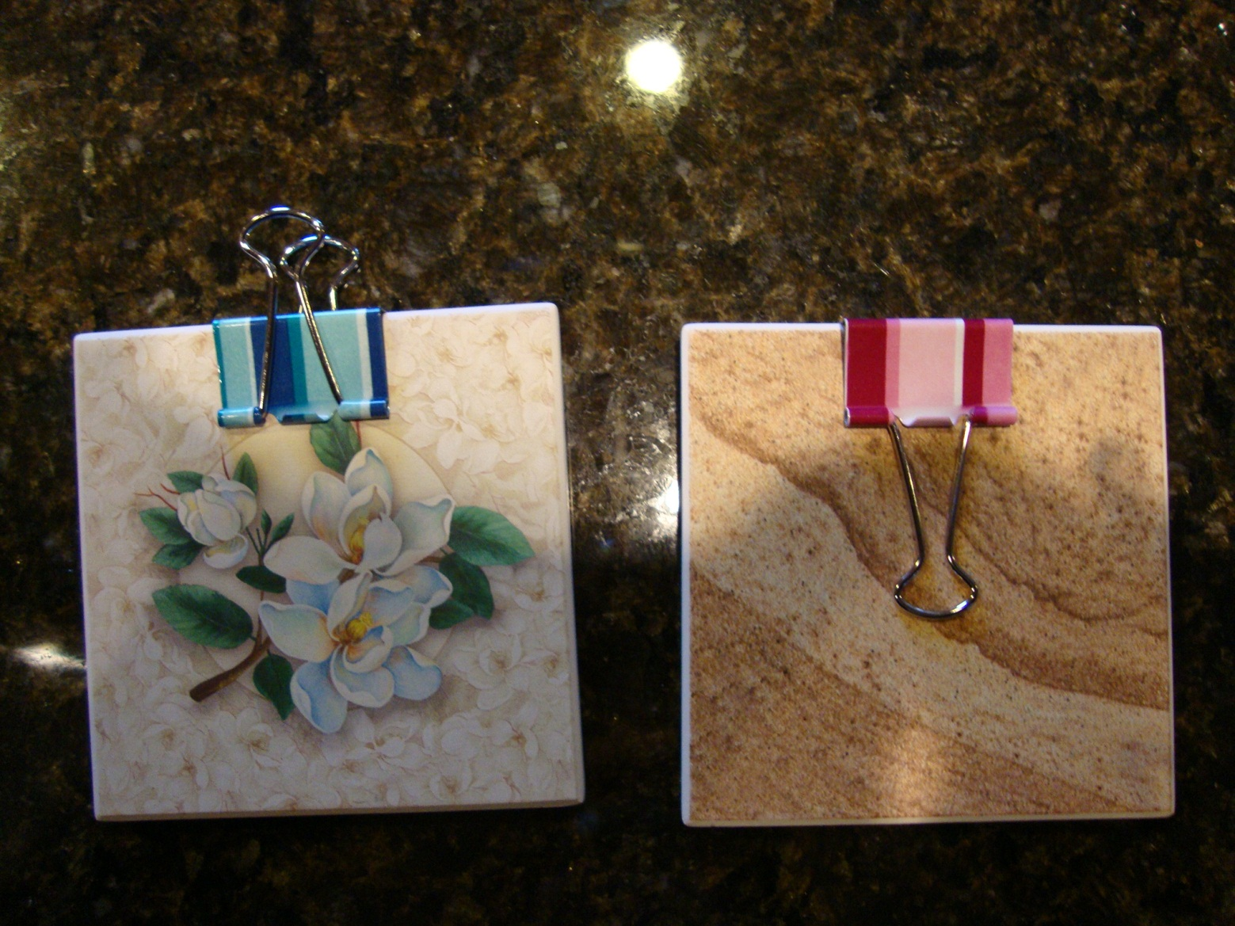
Mini clipboards for teachers to fill out gotchas. Made from coasters and binder clips.

